Slide 1
Payjoins & Coinjoins
aka Torturing Signing Devices

Slide 2



Malcolm pays Zoe 28m sats w/1 utxo
28,793,478
32,776,976
3,982,498
fee
1,000

Slide 3
Malcolm pays Zoe 28m sats w/2 utxos
28,793,478
8,793,478
3,978,710
23,983,498
fee
4,788

Slide 4
PAYJOIN: Malcolm only actually owes Zoe 20m sats
28,793,478
8,793,478
3,978,710
23,983,498
fee
4,788

Slide 5
What does a naive signing device display?
28,793,478
8,793,478
3,978,710
23,983,498
fee
4,788

Slide 6
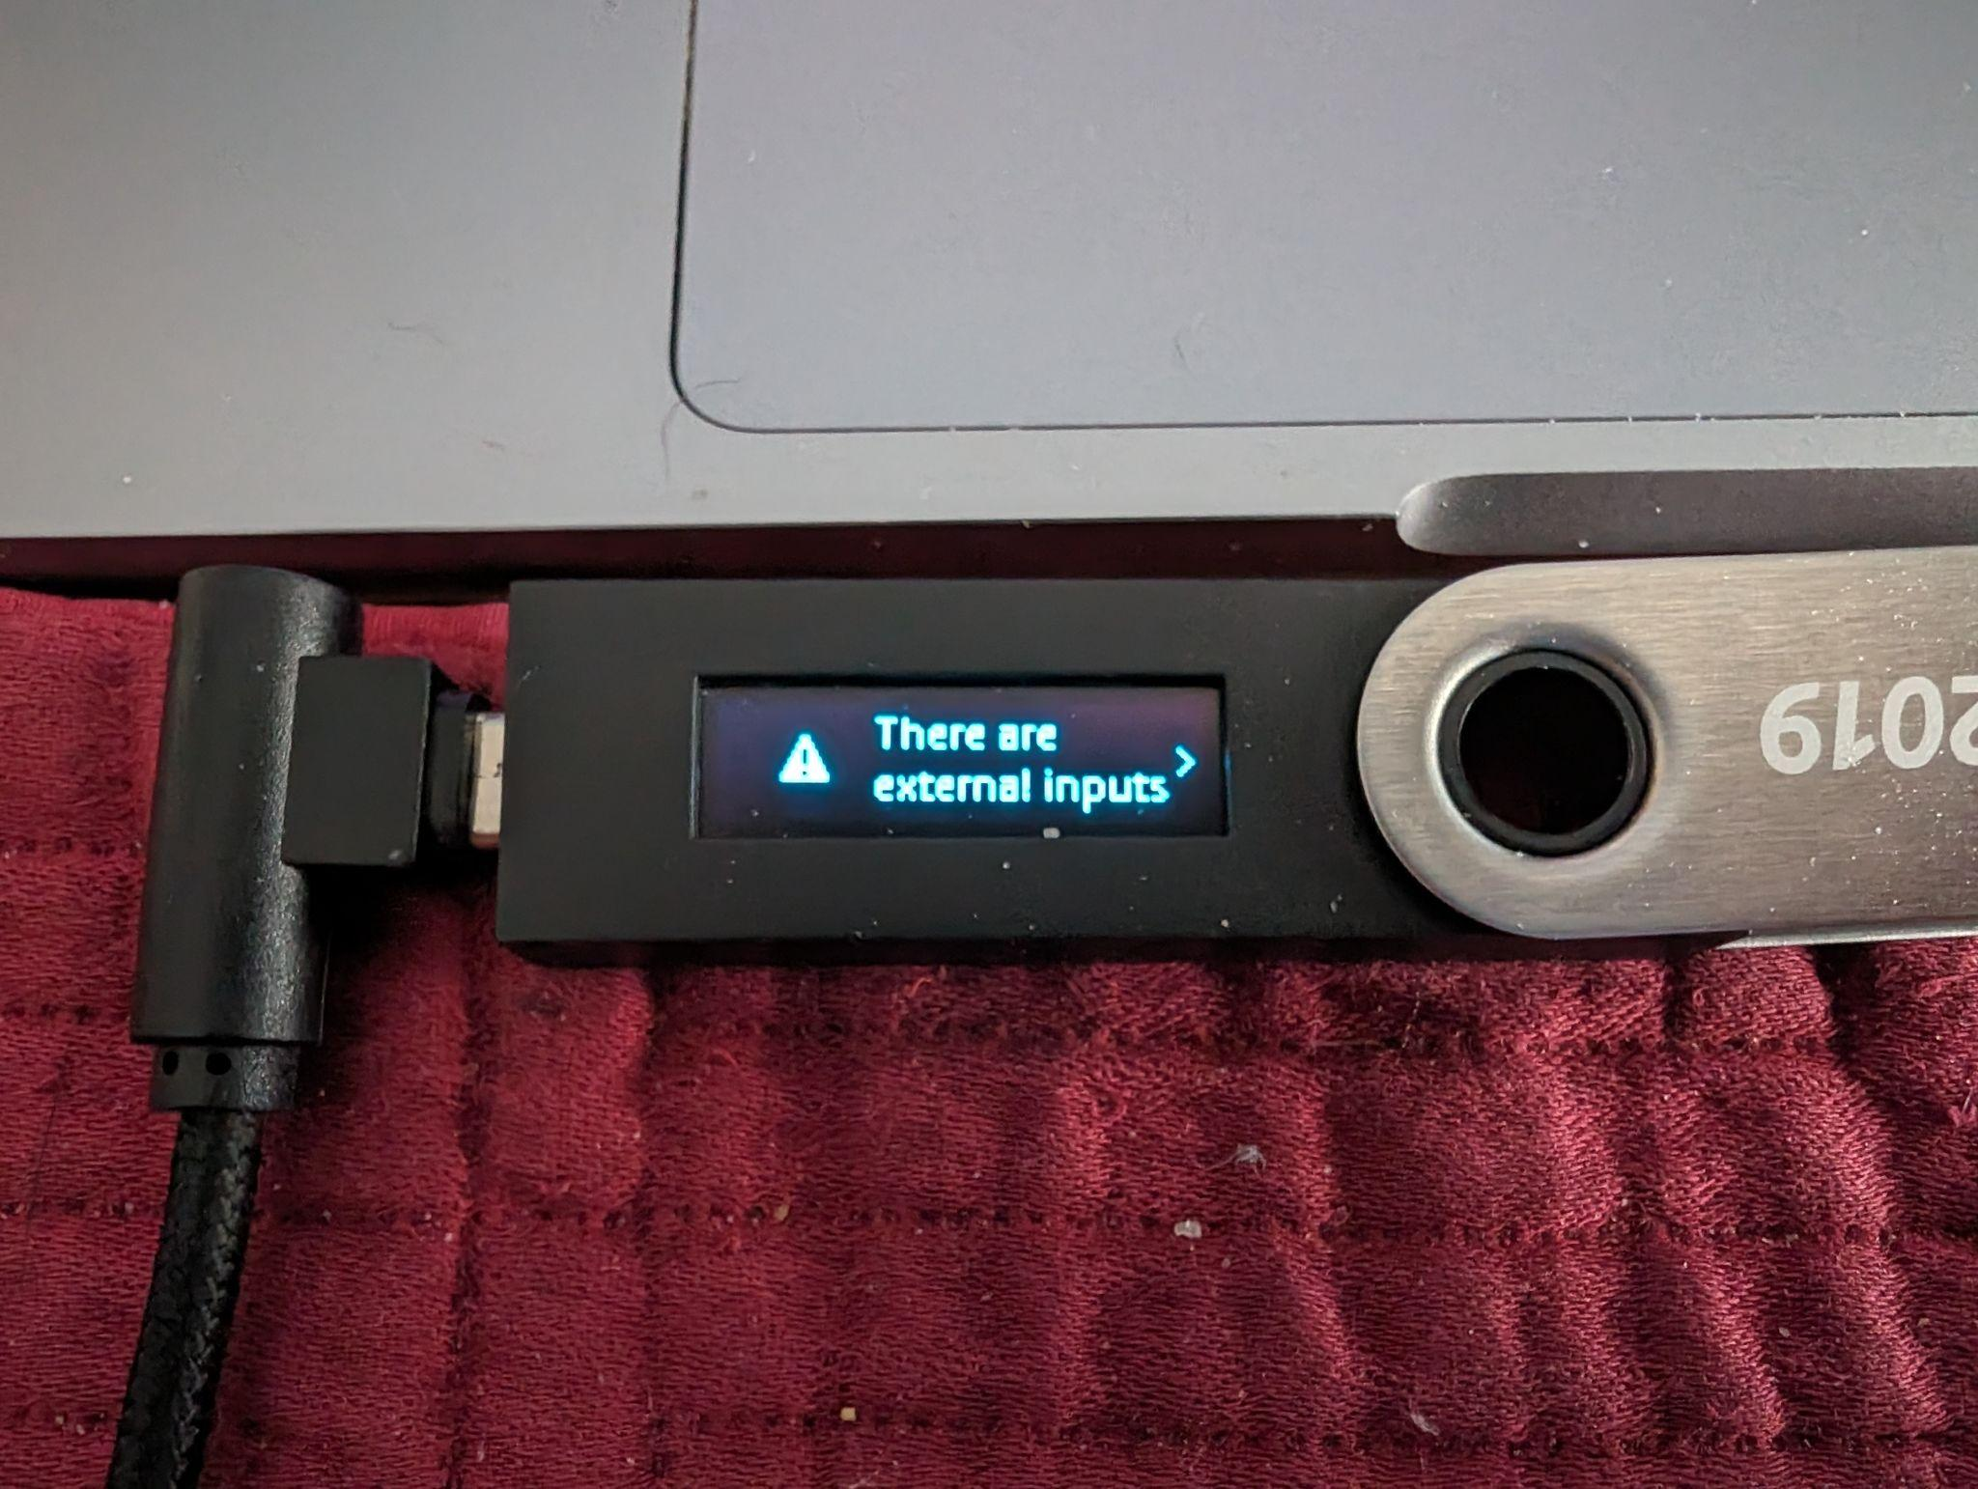
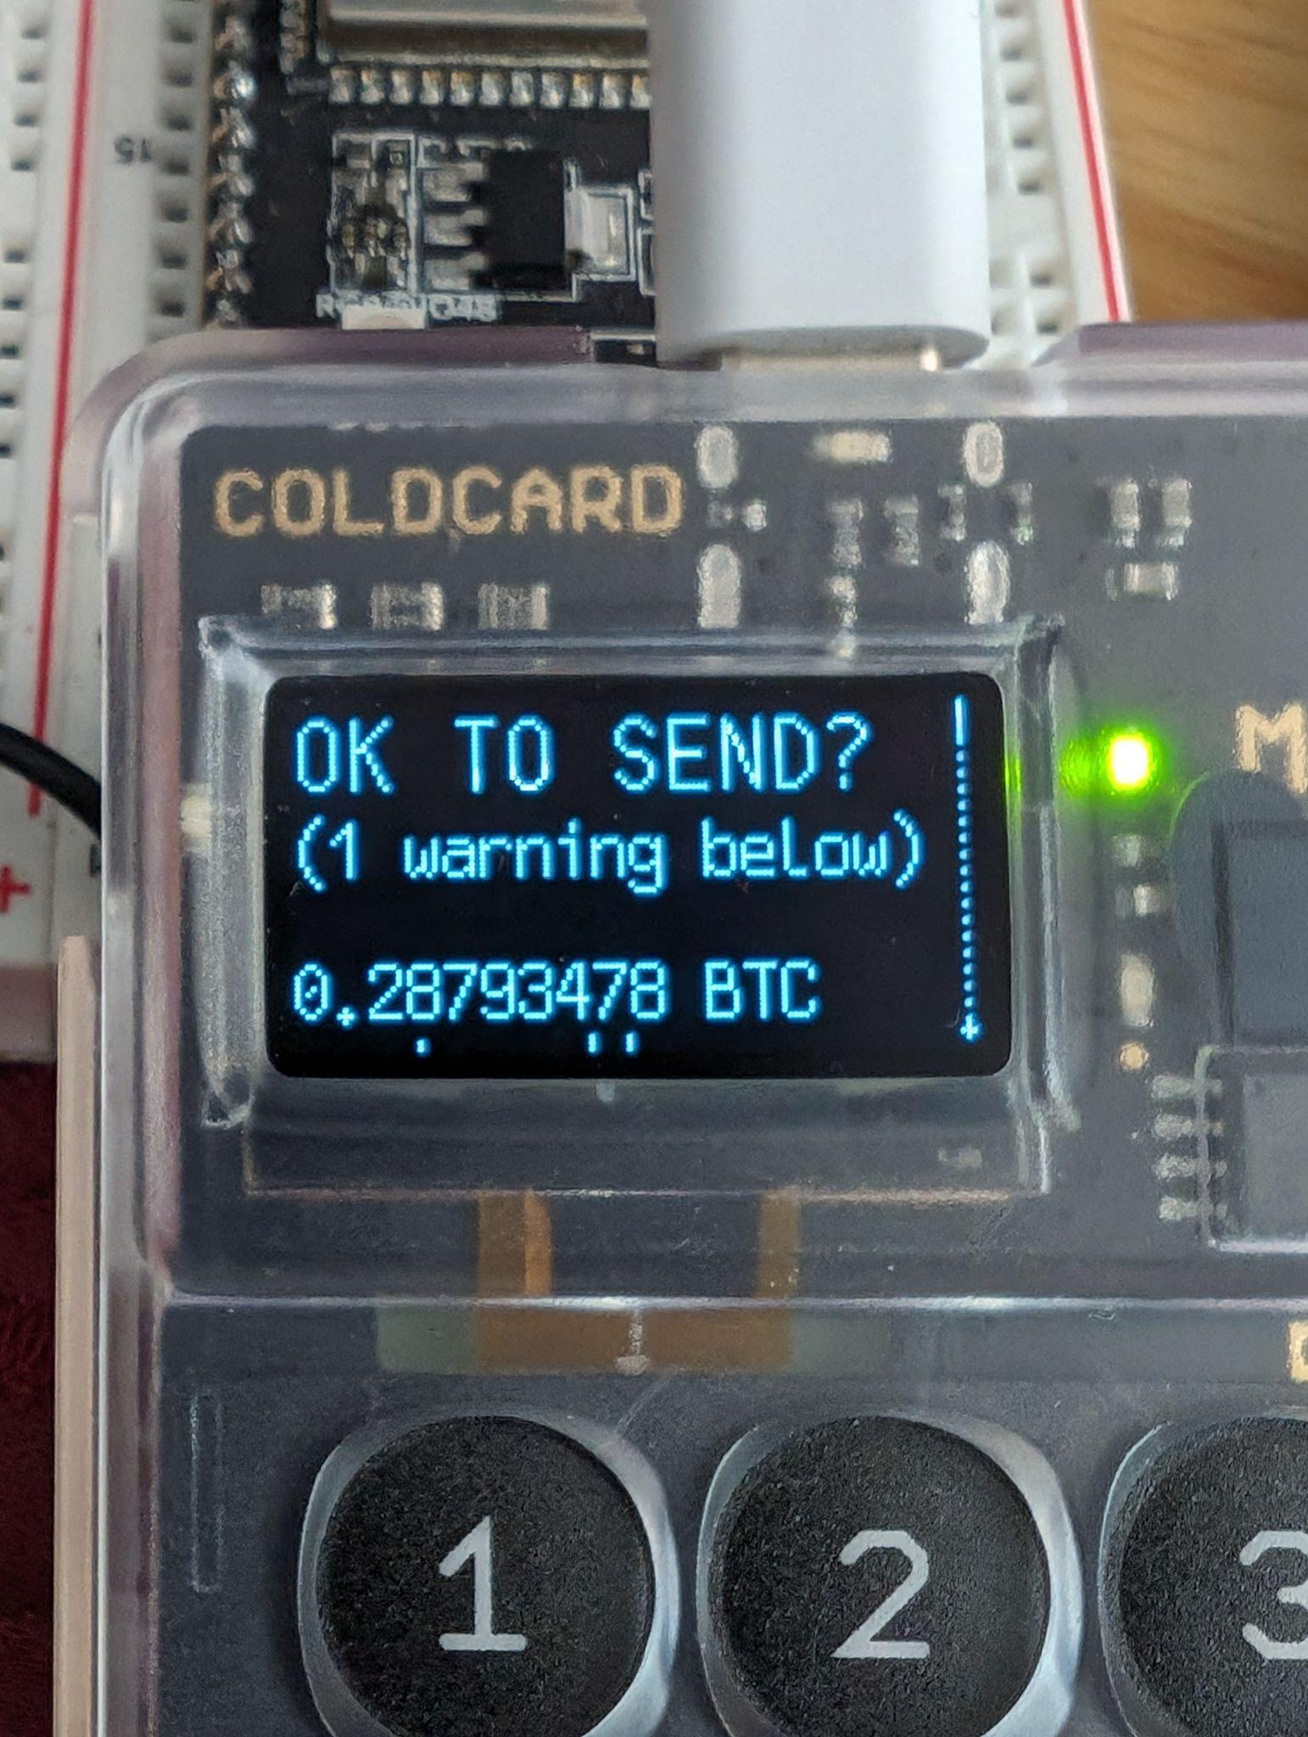
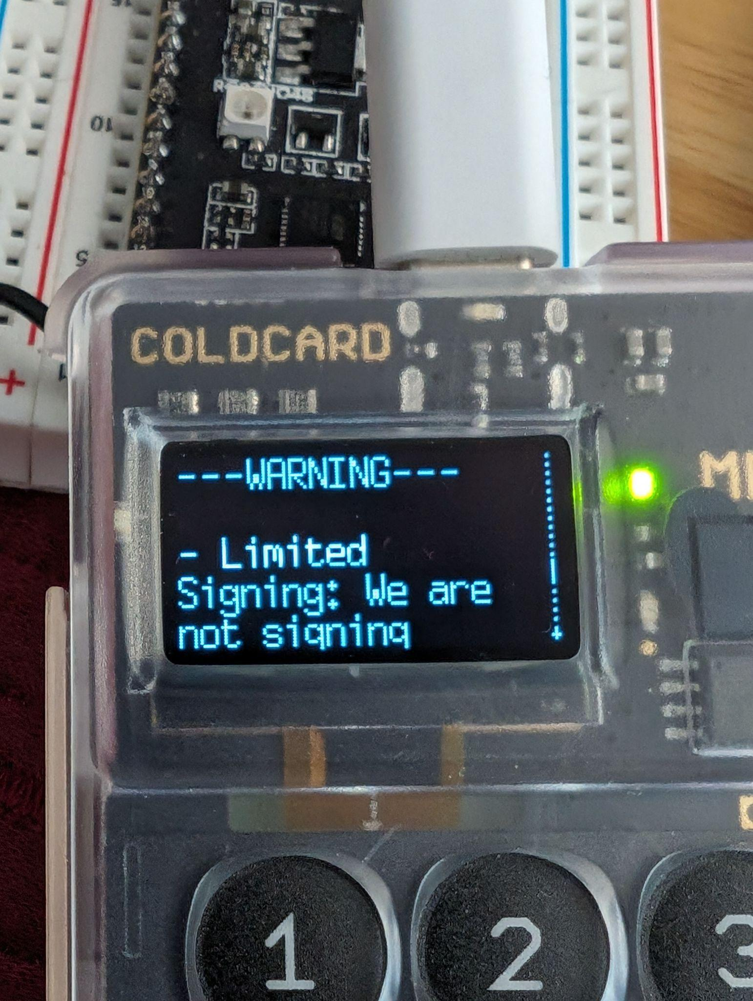
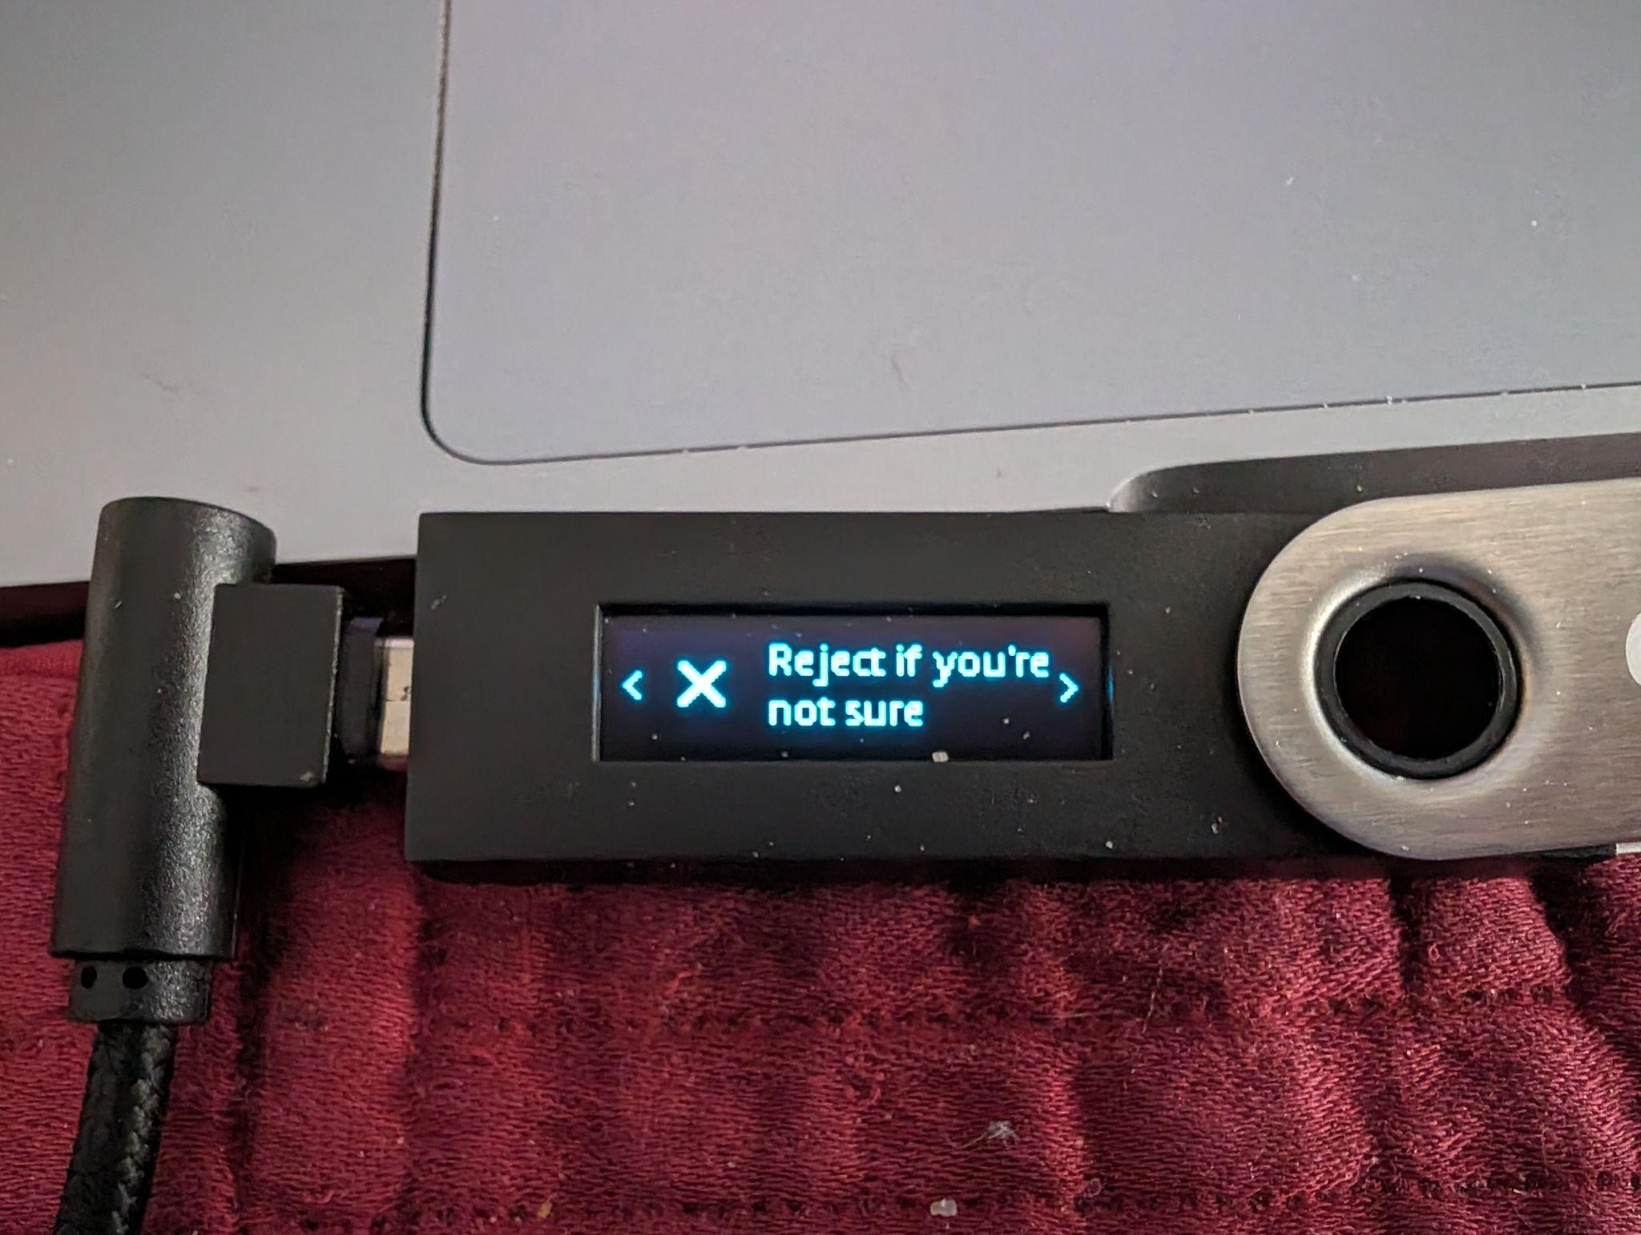
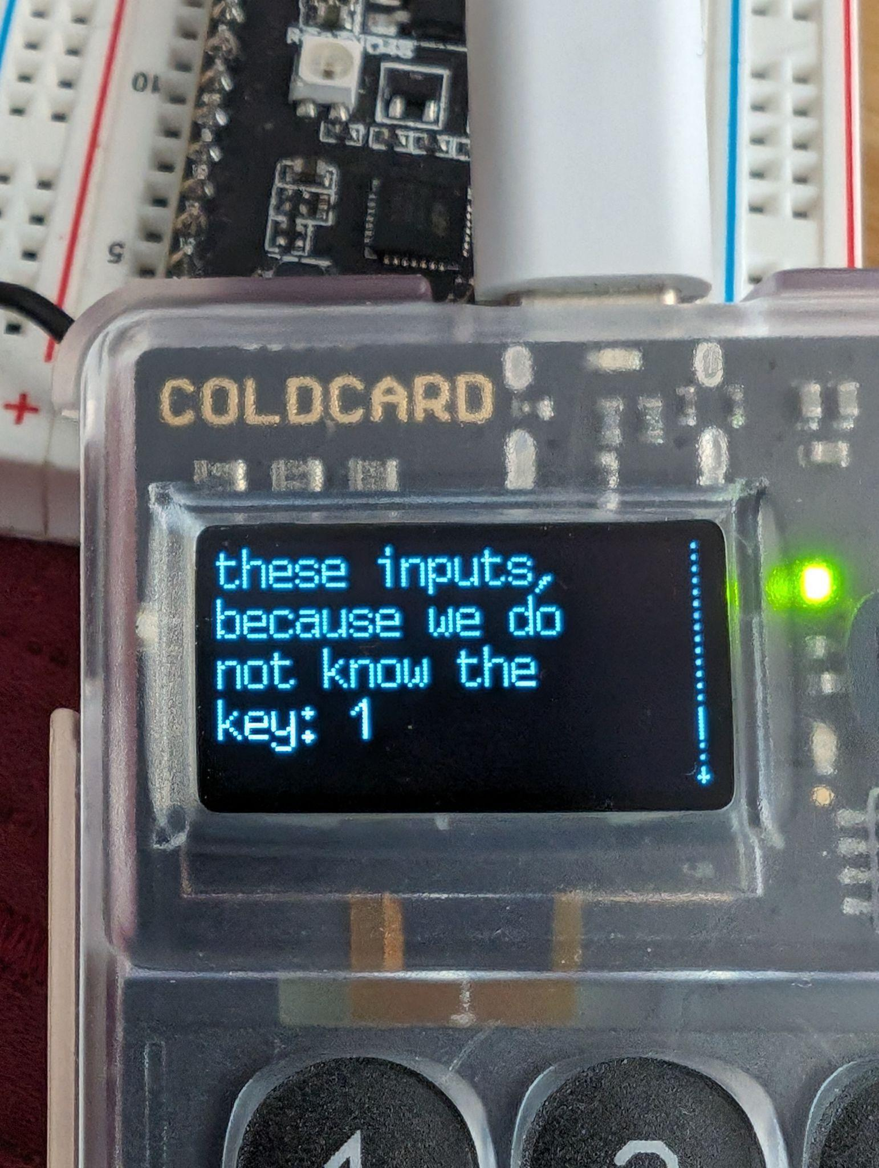
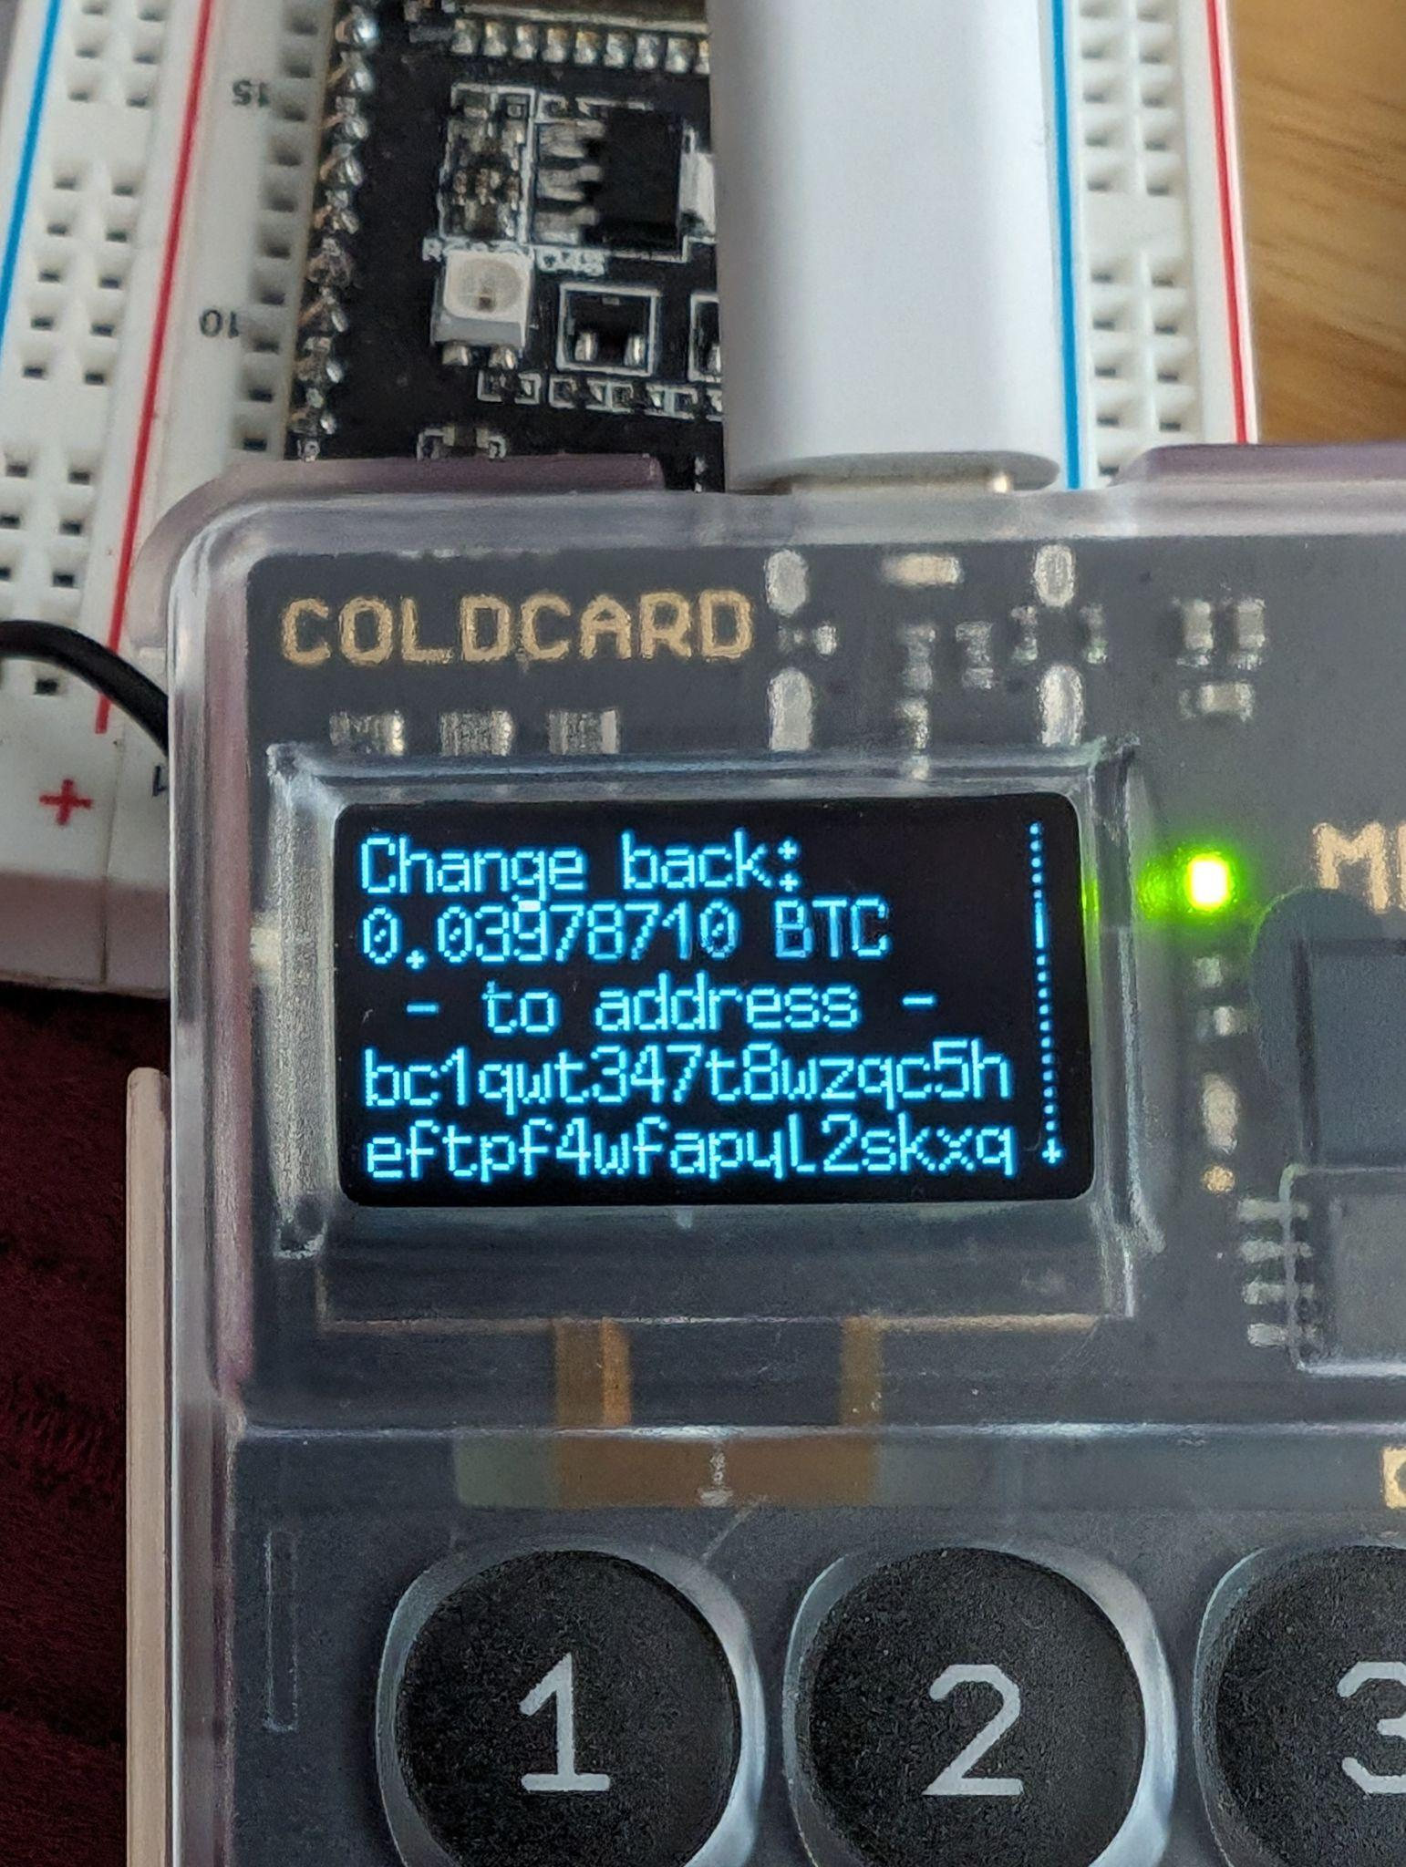
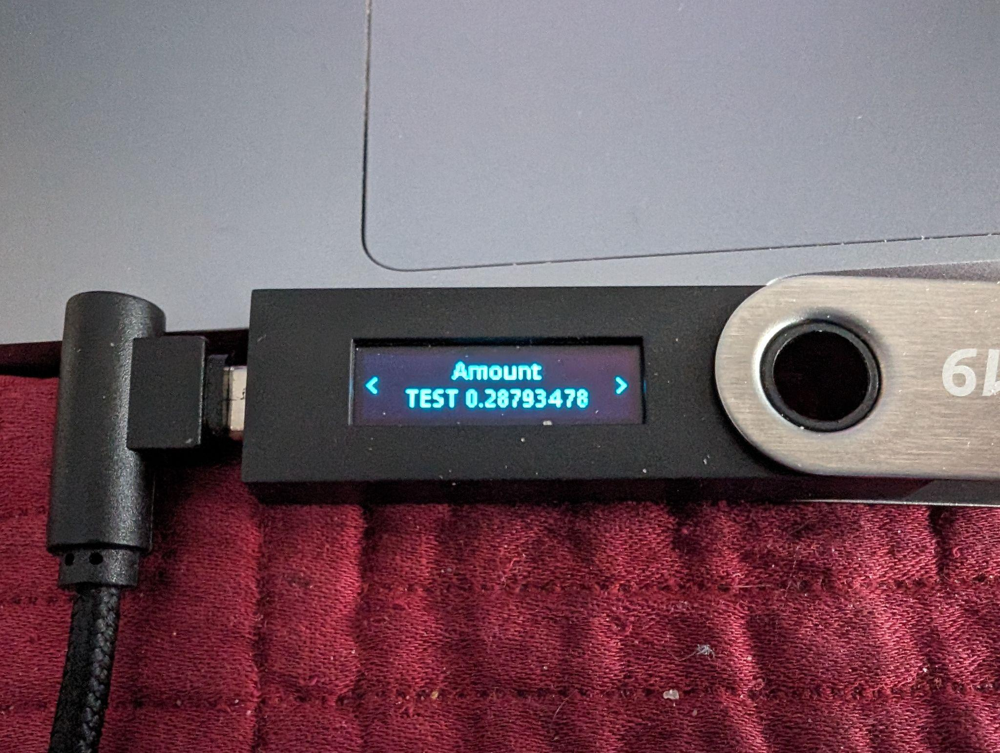
Payjoin: Malcolm’s Perspective
Malcolm owes Zoe 20m sats.
But has to sign for 28m?!

Slide 7
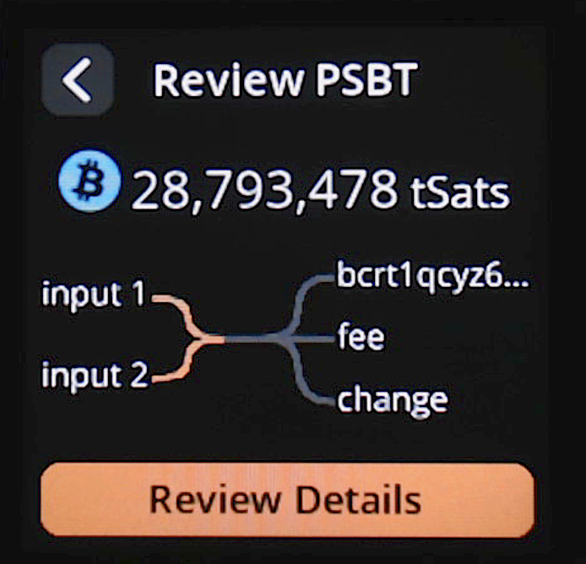
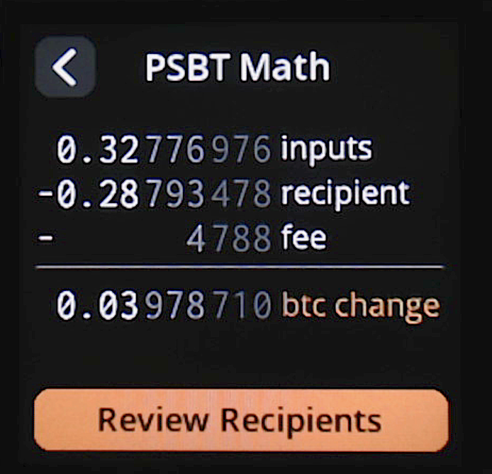
Naive SeedSigner: Womp, Womp… 😢

Slide 8
From Malcolm’s perspective
8,793,478 20,000,000
28,793,478
8,793,478
3,978,710
23,983,498
fee
4,788

Slide 9
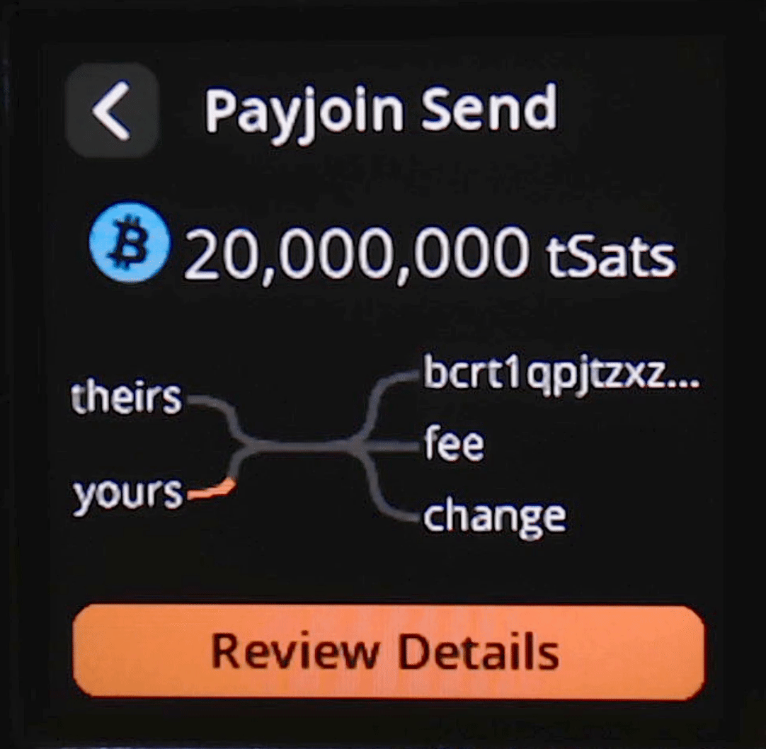
Work-in-Progress: SeedSigner payjoin send

Slide 10
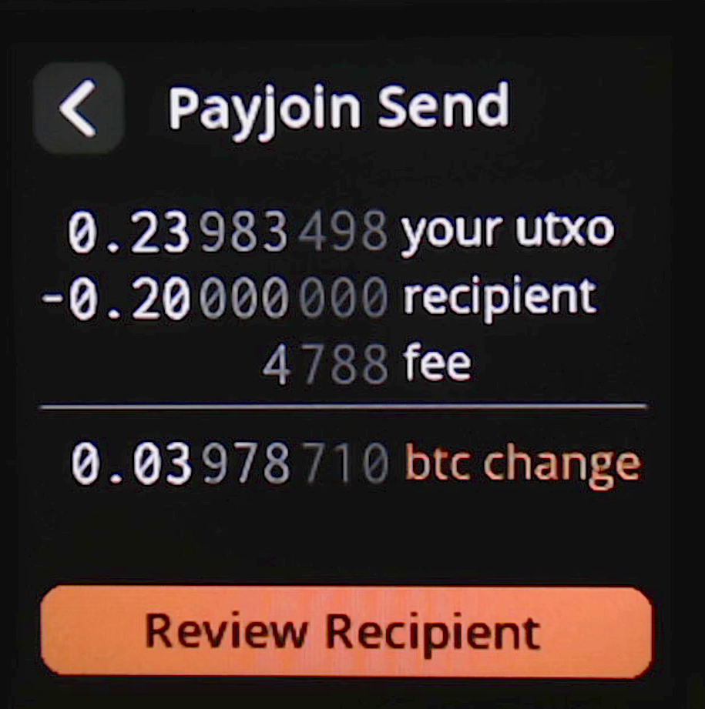
Work-in-Progress: SeedSigner payjoin send

Slide 11
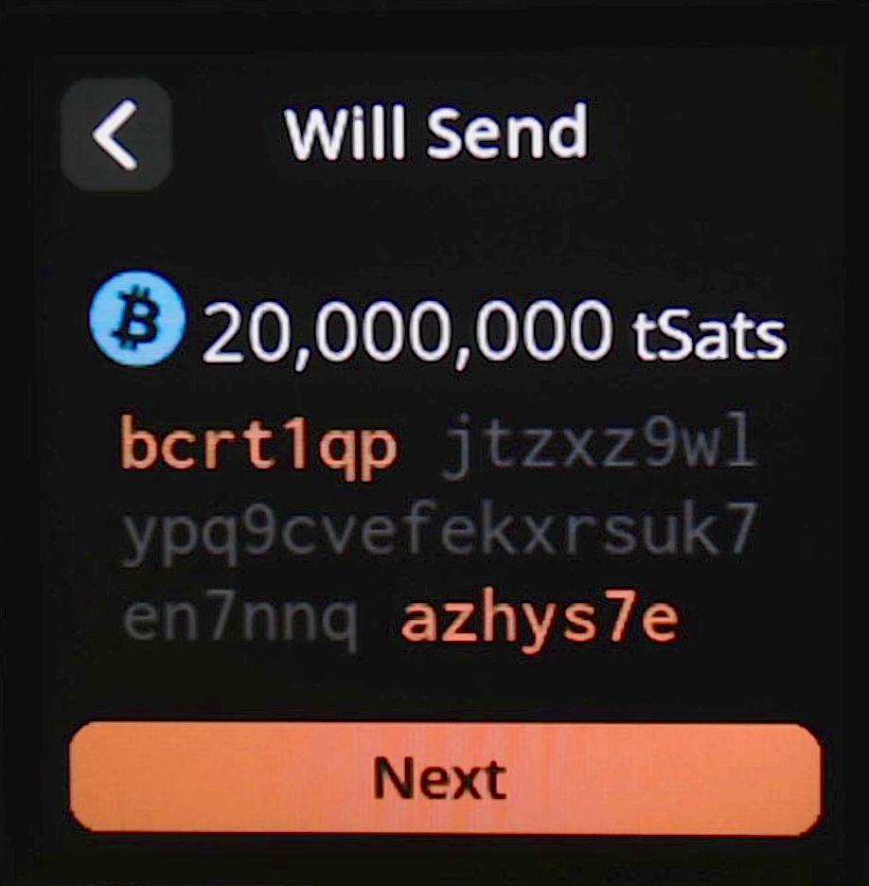
Work-in-Progress: SeedSigner payjoin send

Slide 12
But Zoe has to sign the tx, too!
28,793,478
8,793,478
3,978,710
23,983,498
fee
4,788

Slide 13
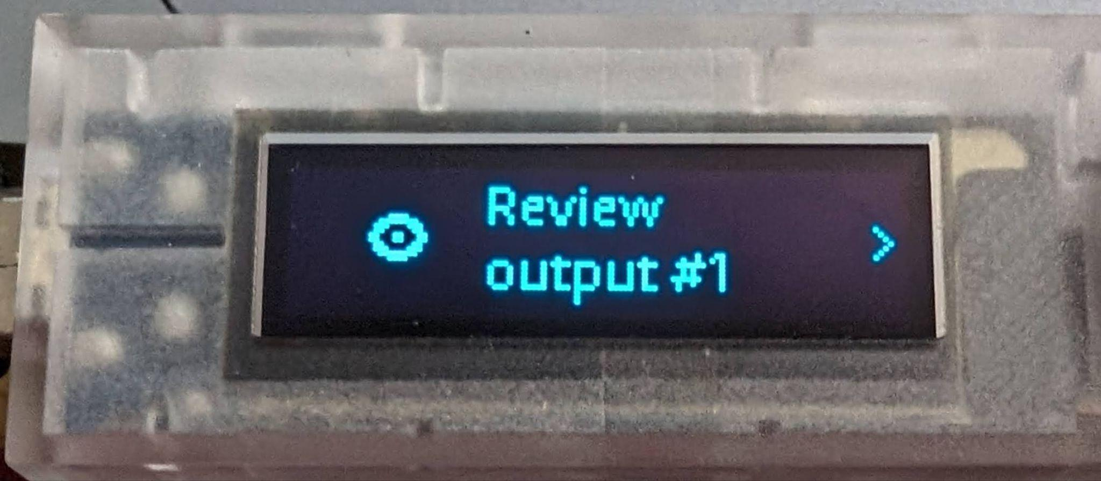
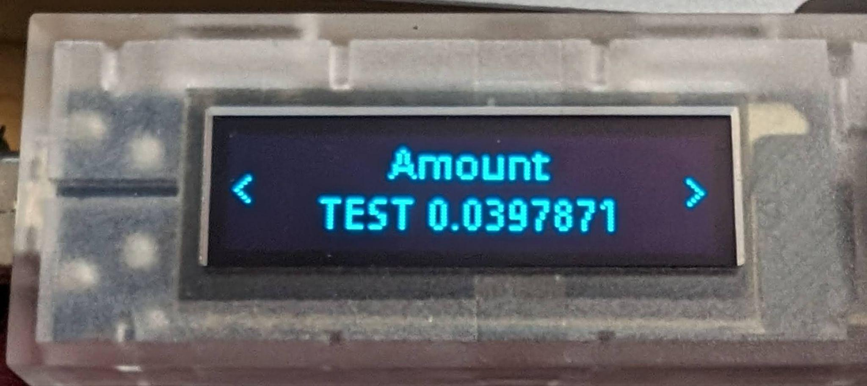
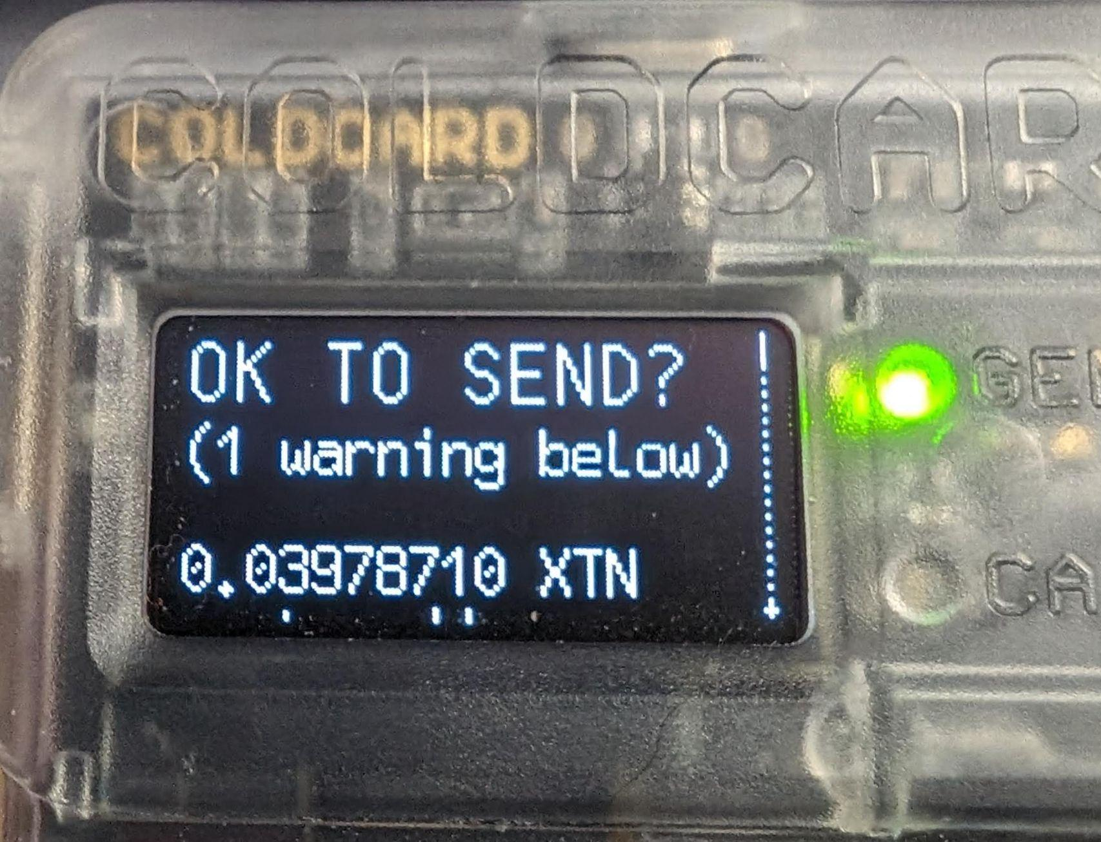
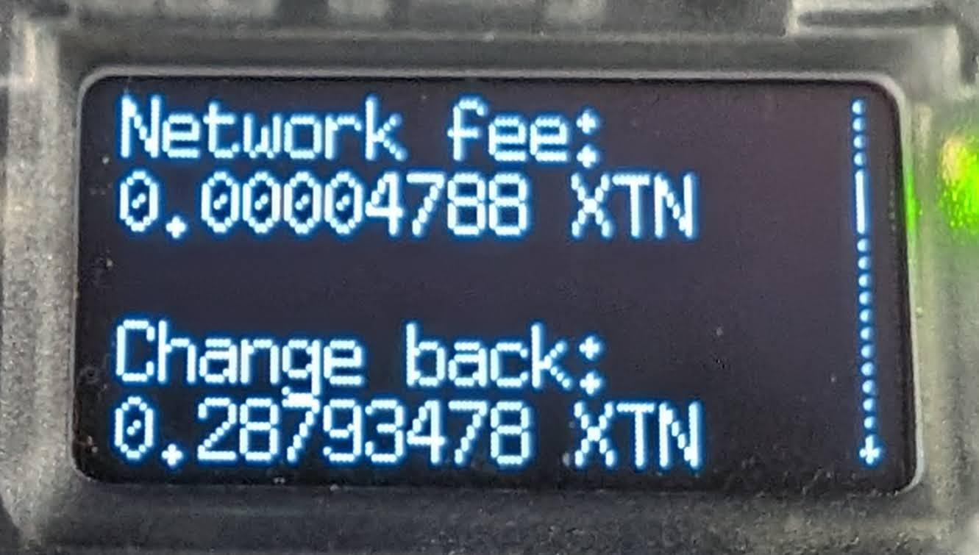
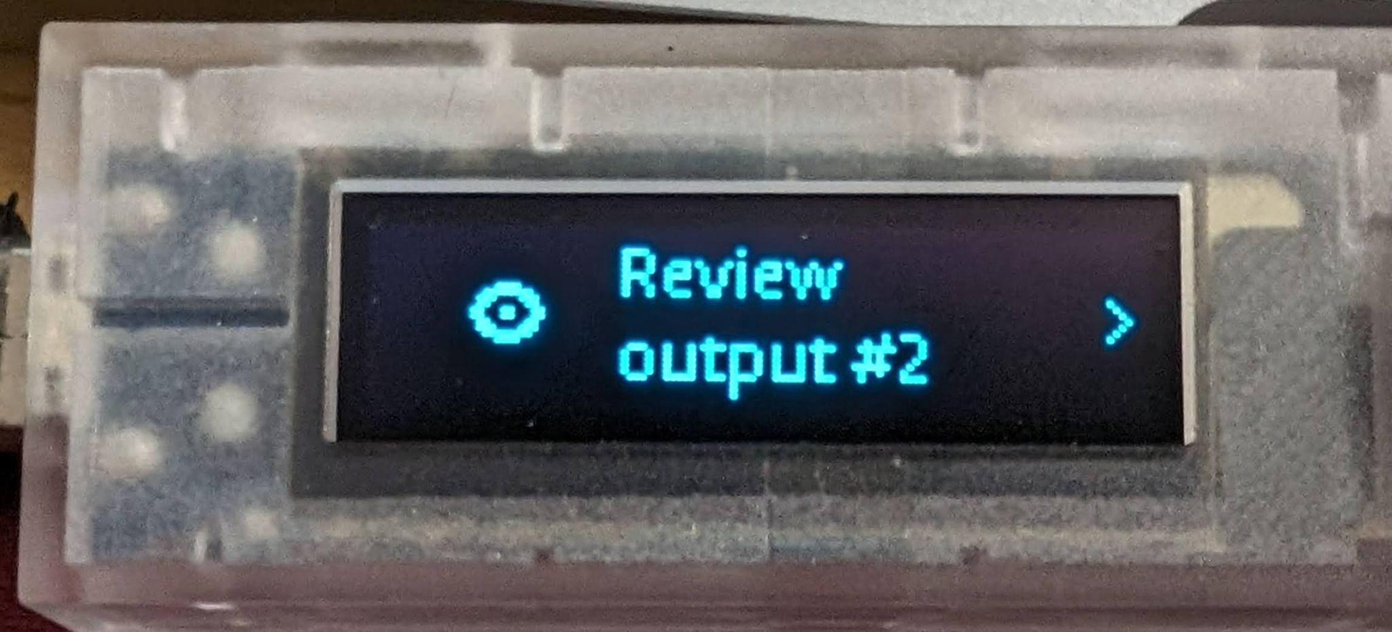
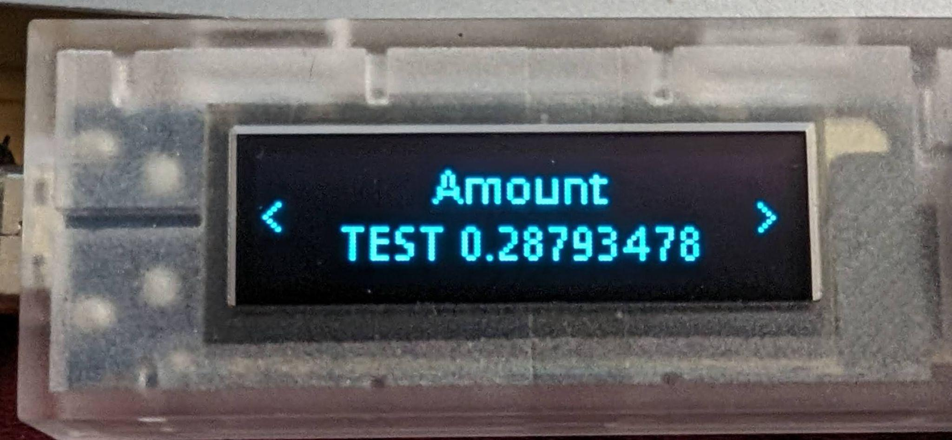
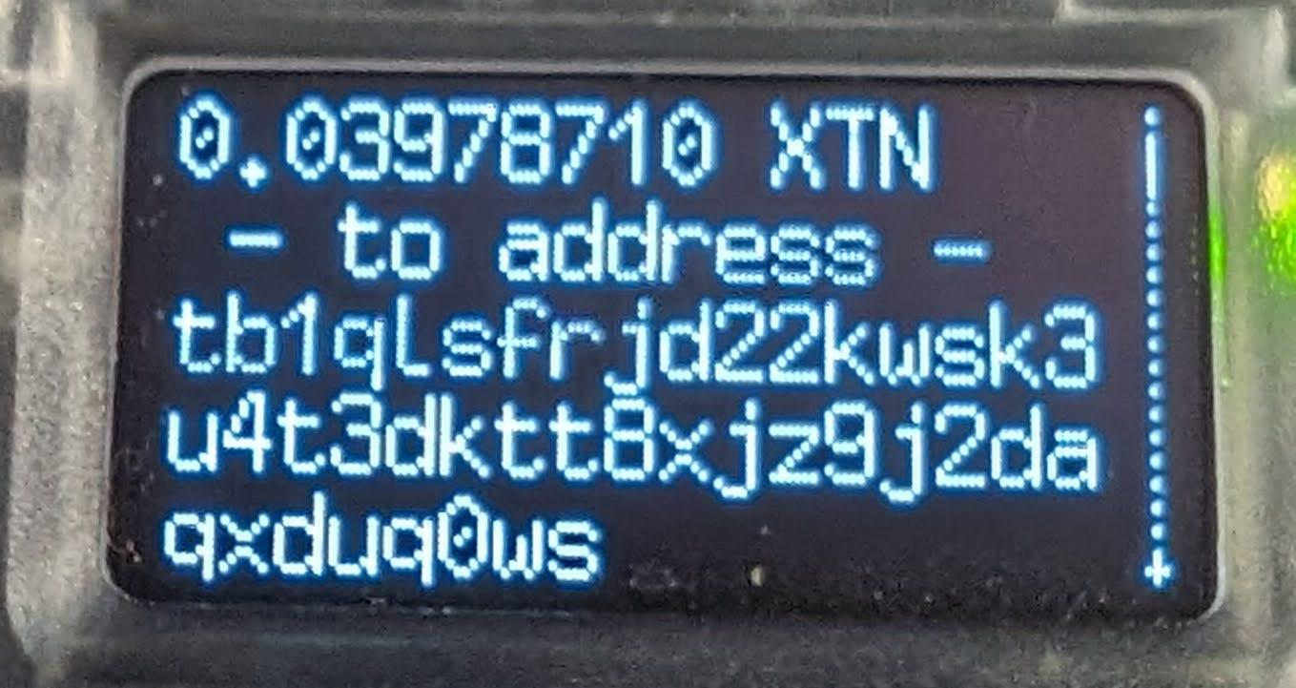
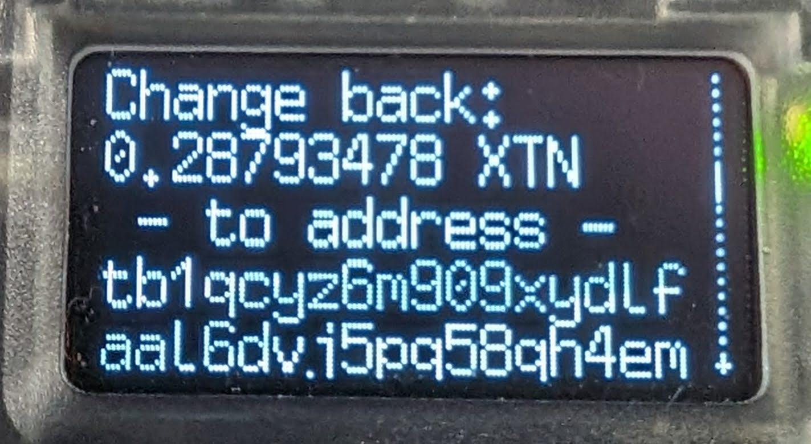
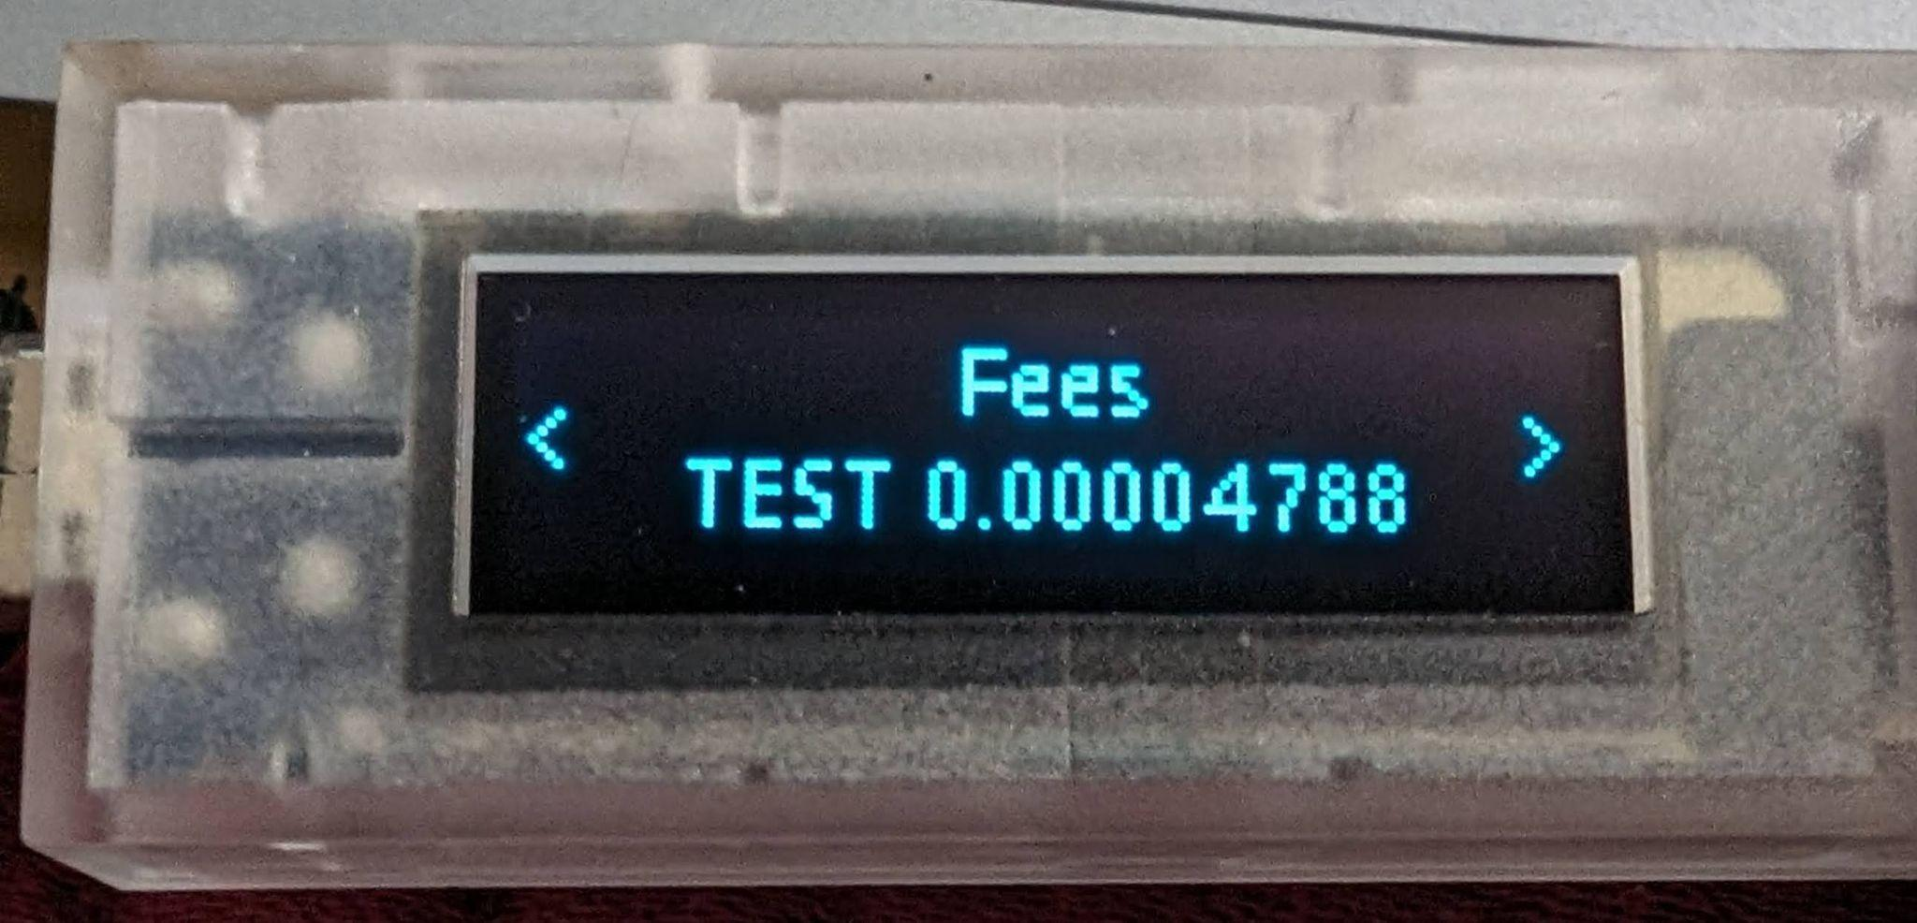
Payjoin: Zoe’s Perspective
Is Zoe funding Malcolm’s change?
Is Zoe OVERpaying herself?
Is Zoe paying fees?

Slide 14
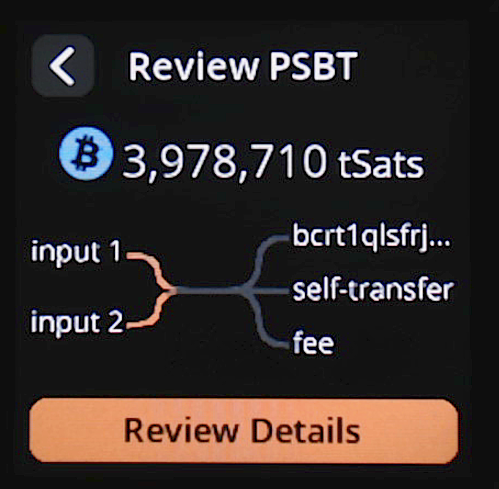
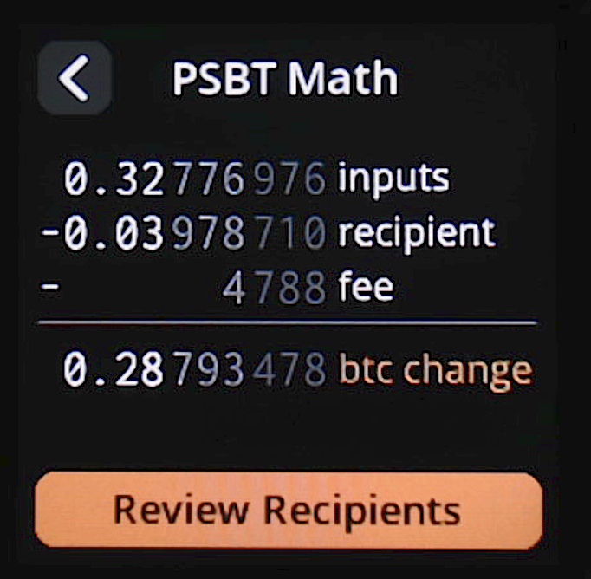
But naive SeedSigner…? Still 😢

Slide 15
So what does Zoe care about?
8,793,478 +20,000,000
8,793,478
🤷‍♂️
3,978,710
23,983,498
fee
4,788

Slide 16
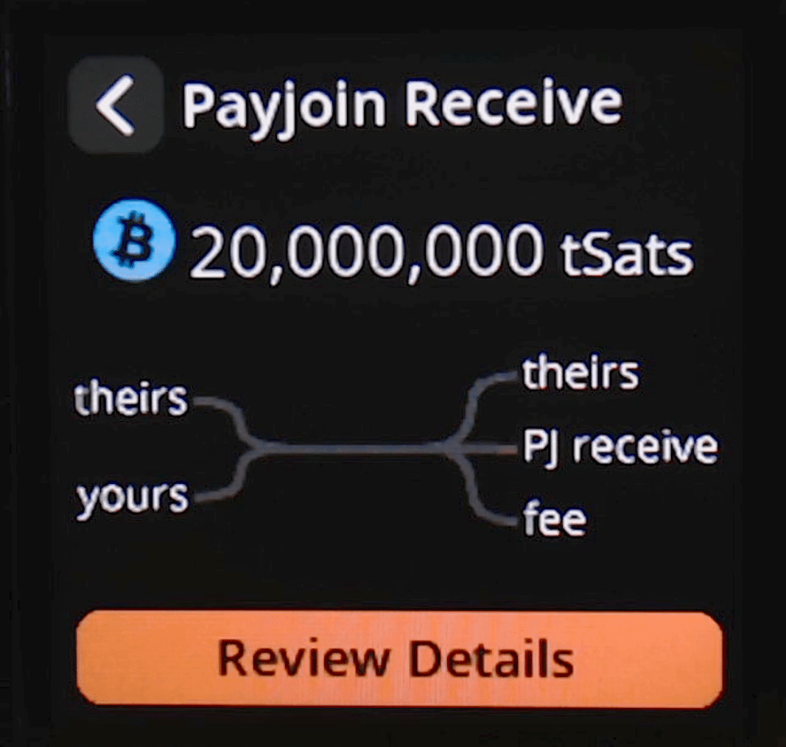
Work-in-Progress: SeedSigner payjoin receive

Slide 17
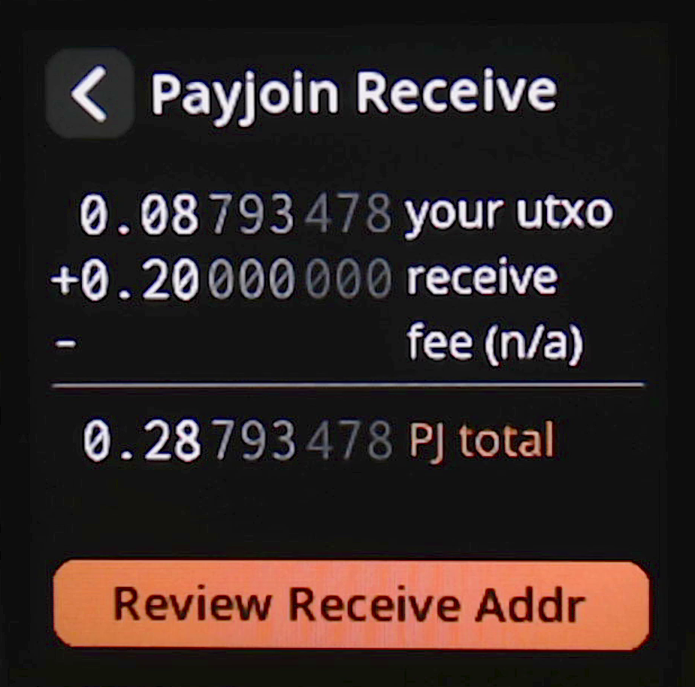
Work-in-Progress: SeedSigner payjoin receive

Slide 18
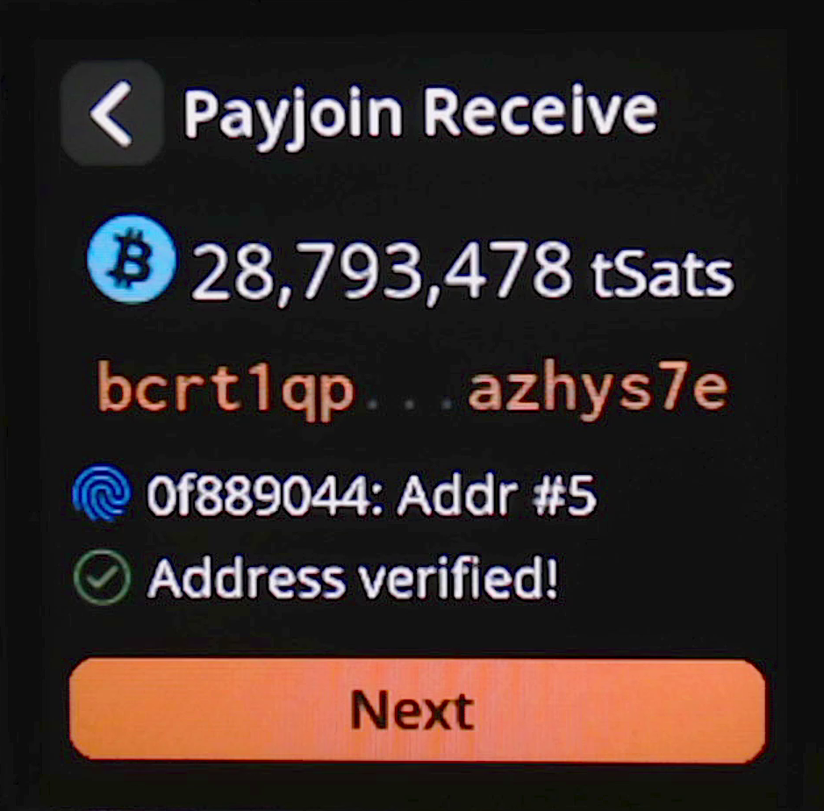
Work-in-Progress: SeedSigner payjoin receive

Slide 19
How about a coinjoin?
25,000,000
each
61,206,177
22,048,847
11,200,856
1,005,120
53,964,662
fee
13,710

Slide 20
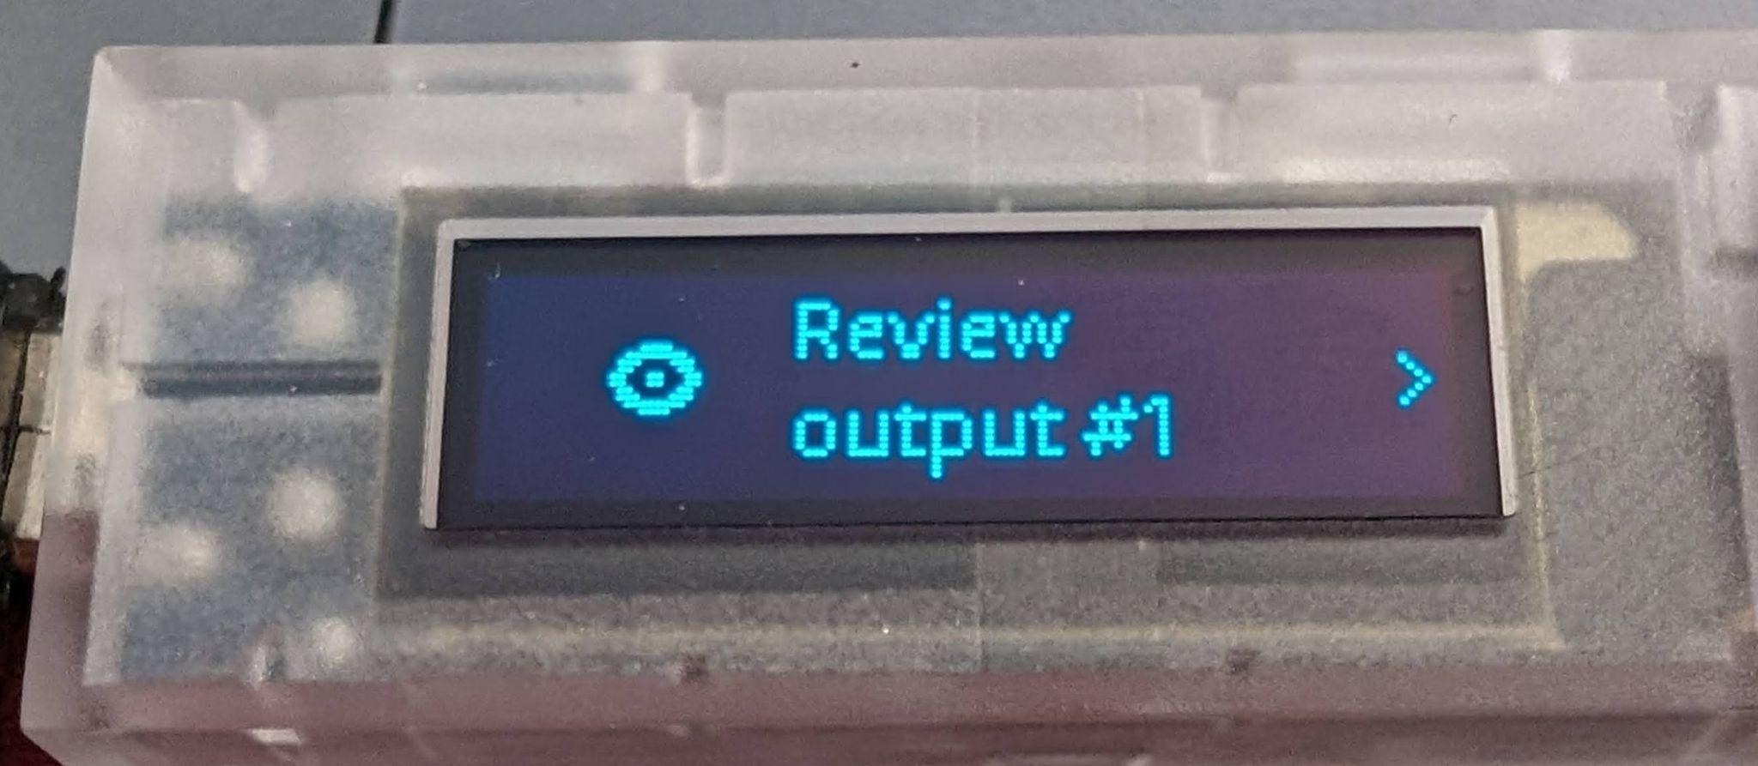
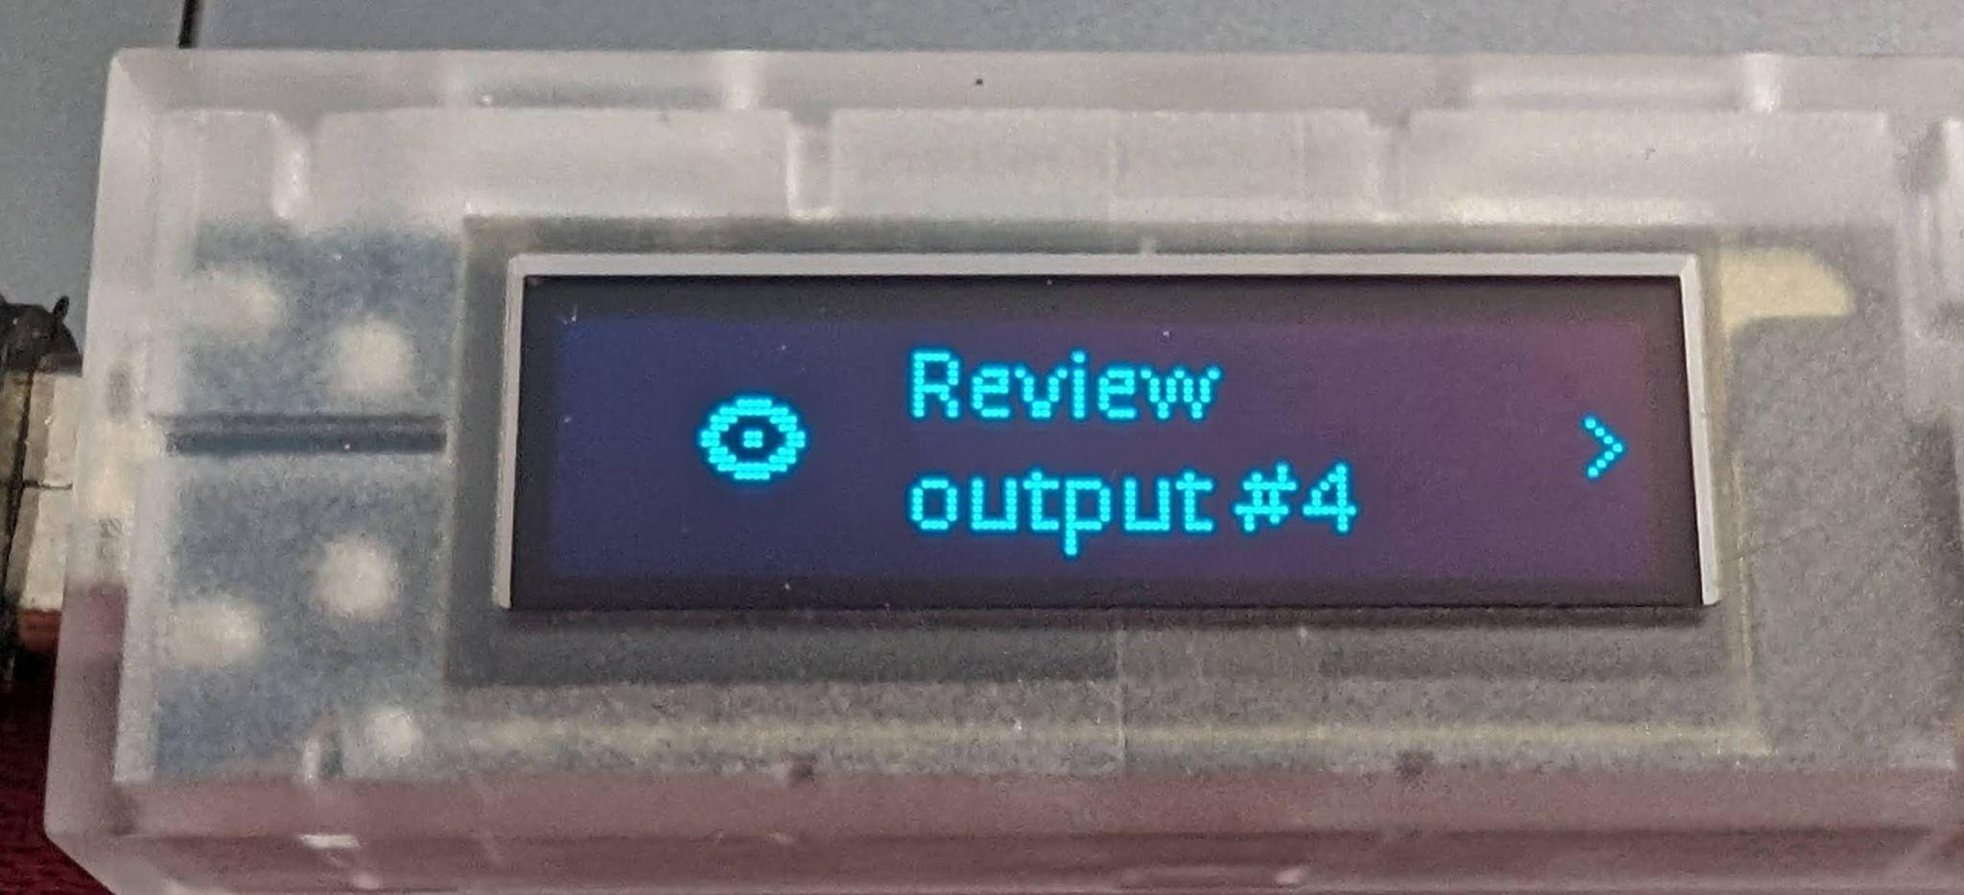
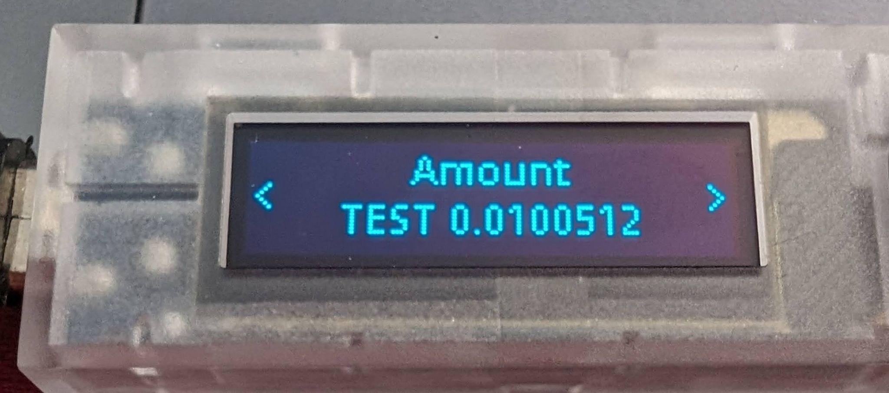
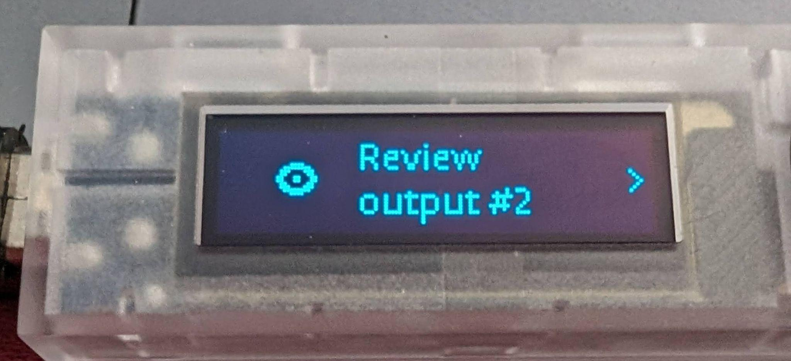
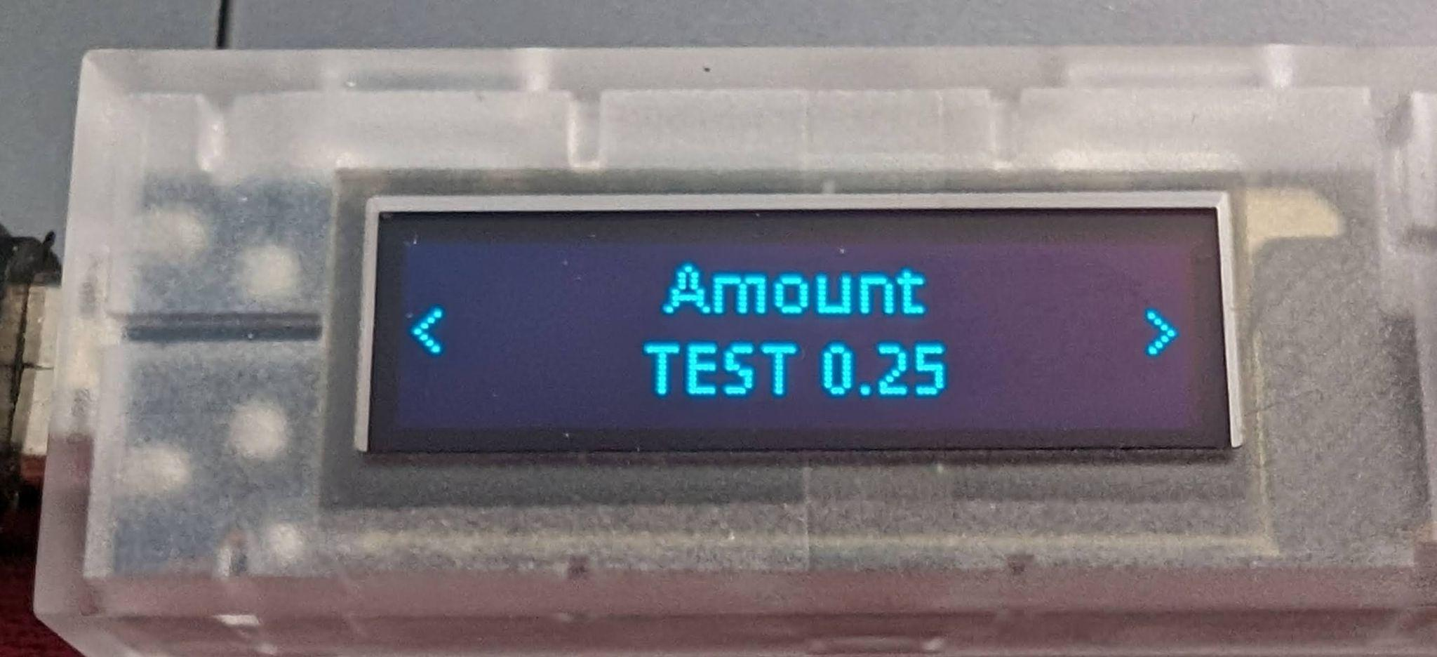
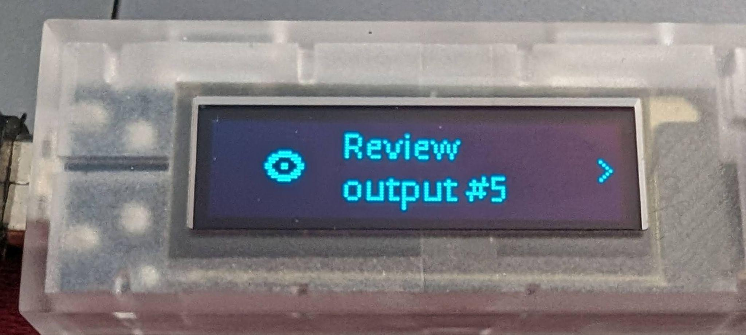
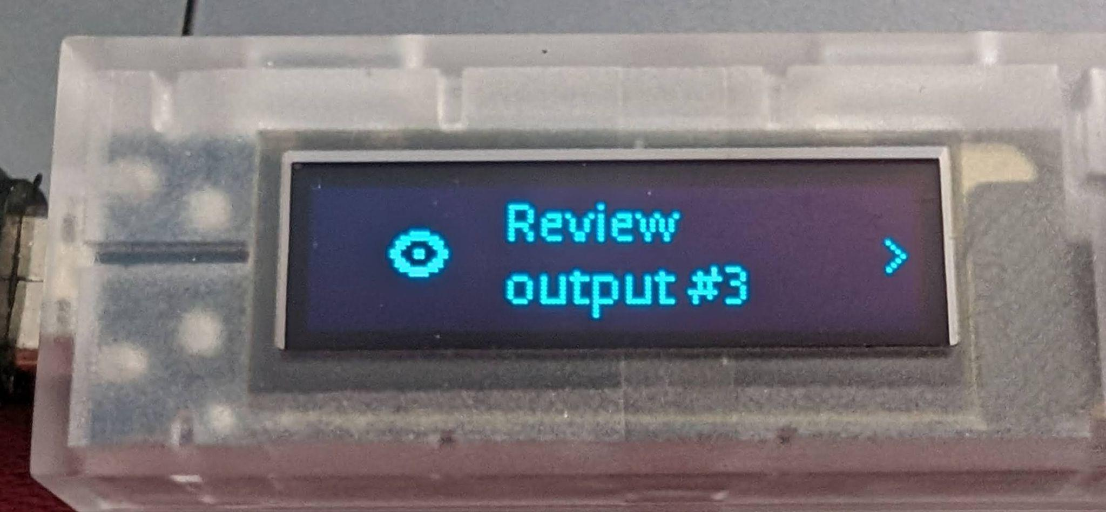
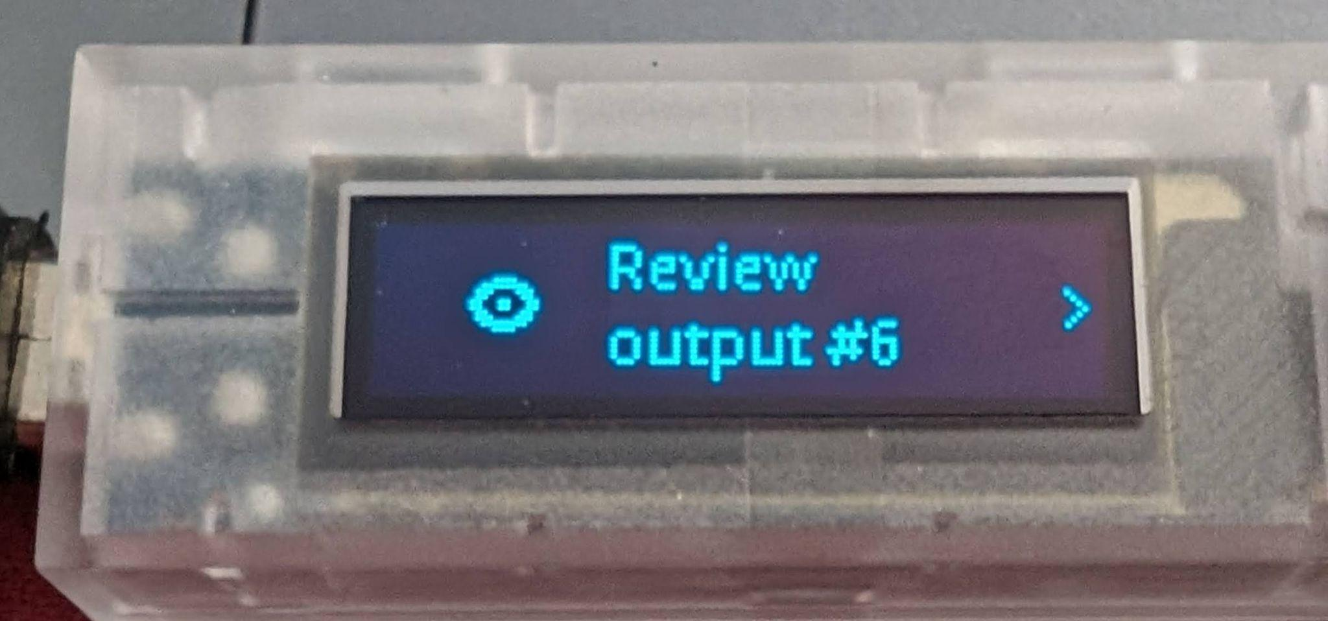
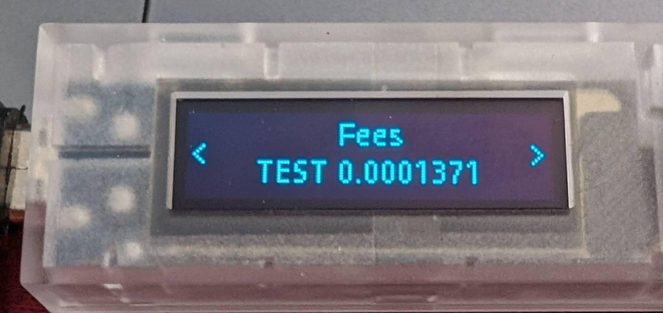
Coinjoin: Zoe’s perspective
Review ALL 5 equal-size output addrs
Malcolm’s change
Is Zoe paying all the fees?

Slide 21
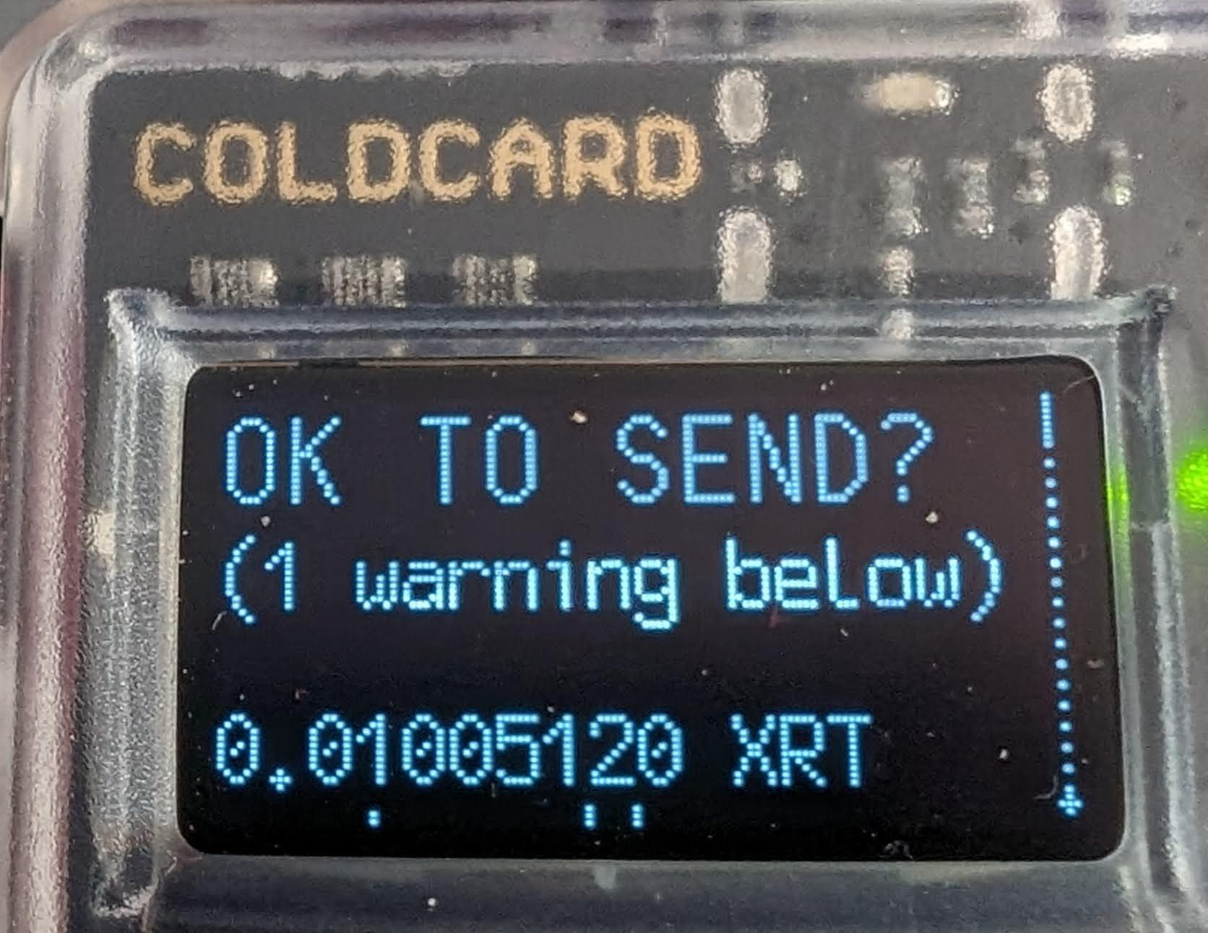
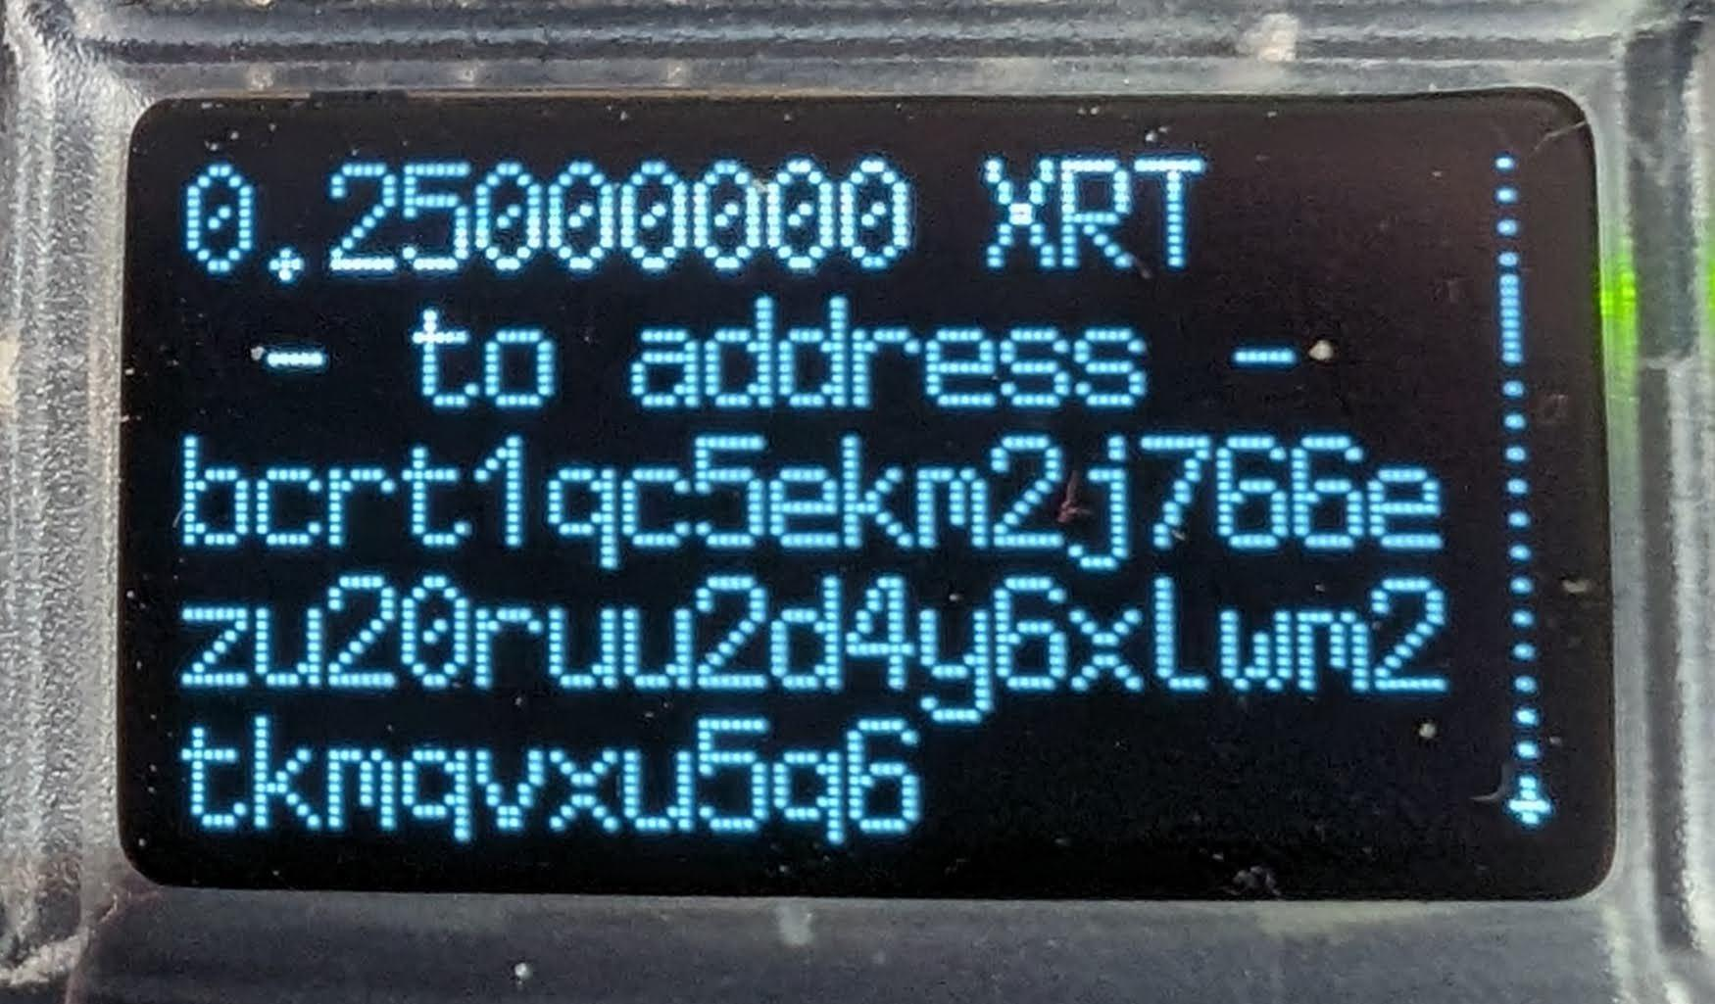
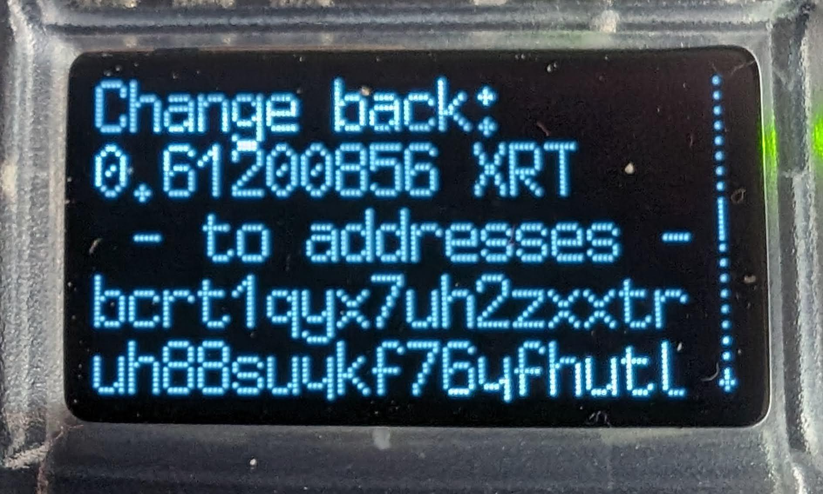
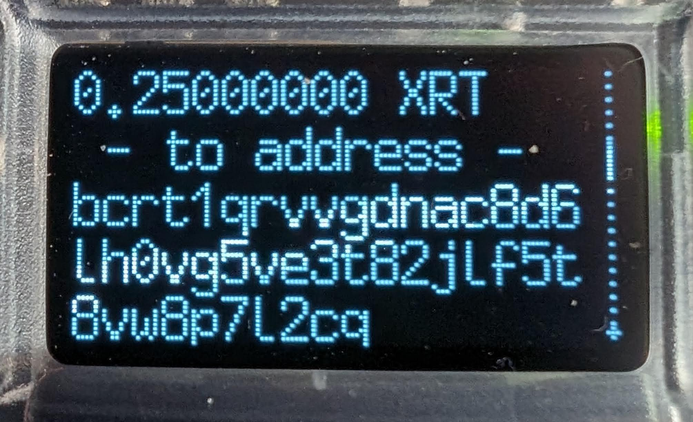
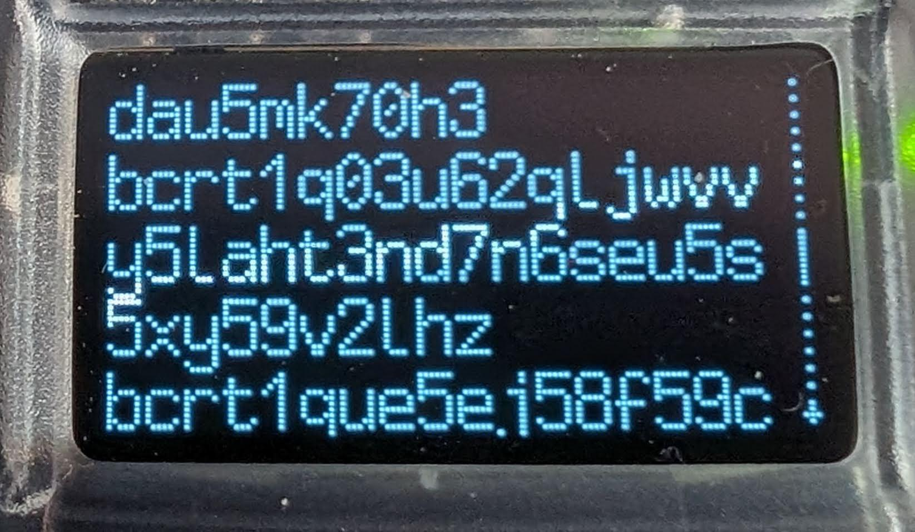
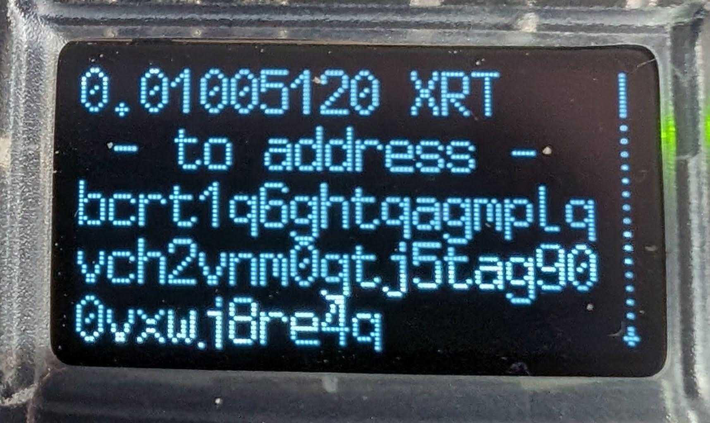
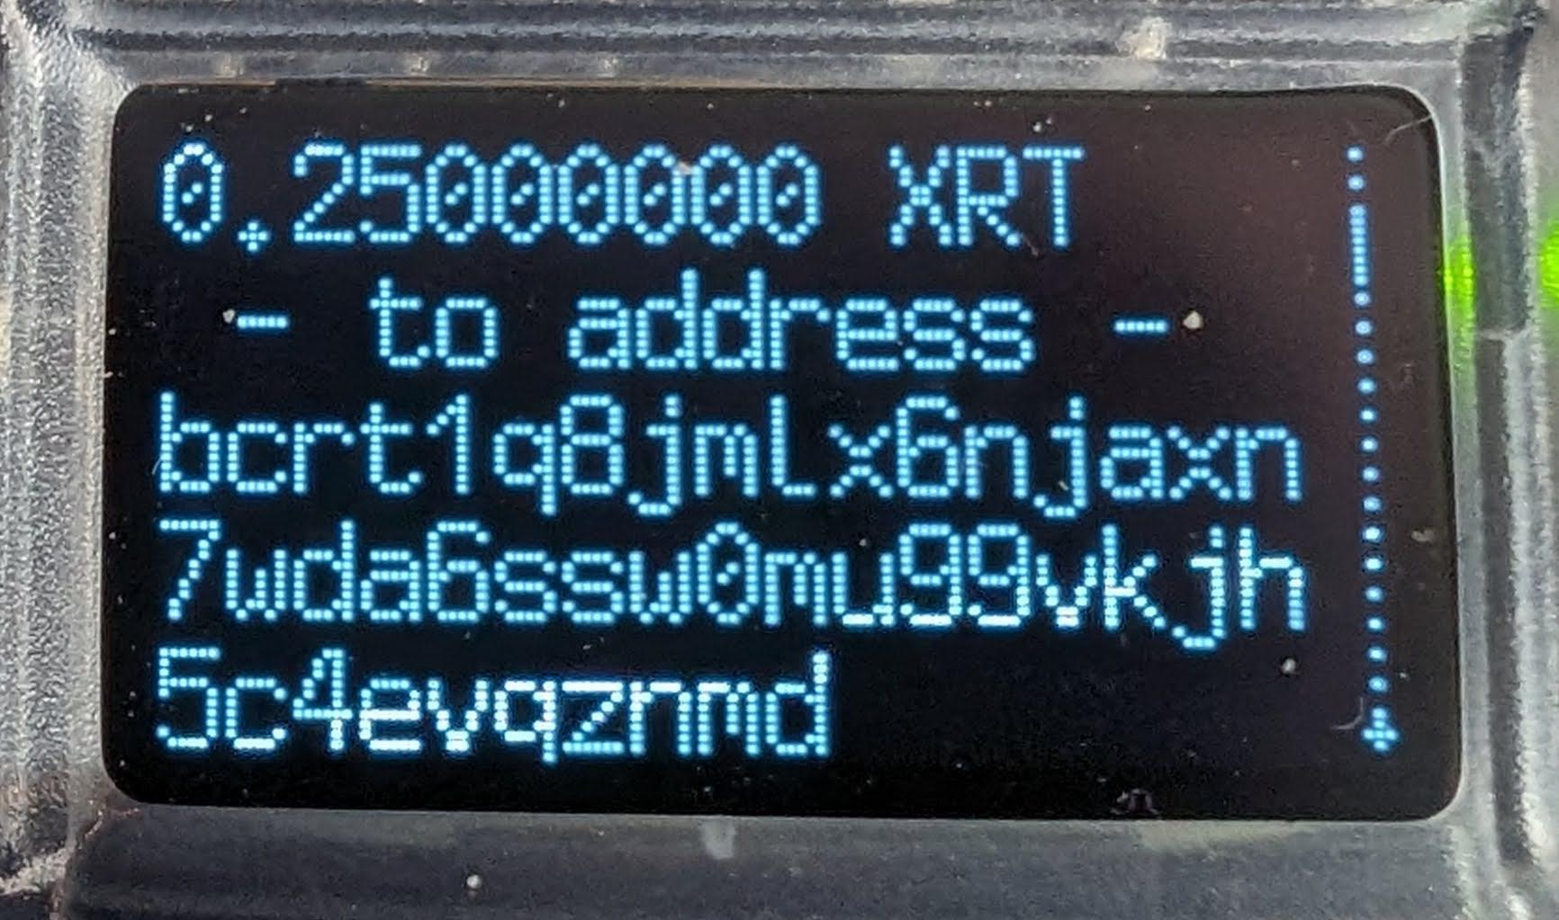
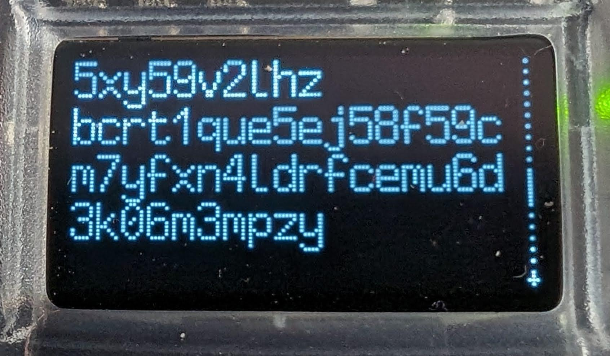
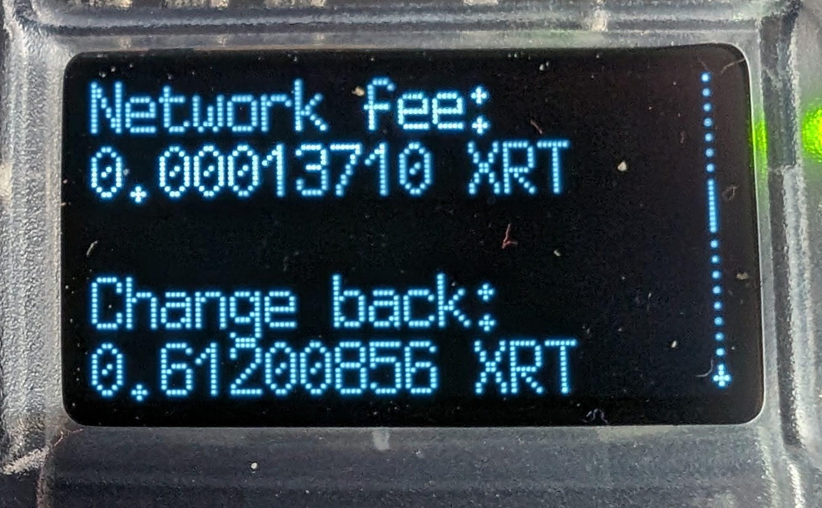
Coinjoin: Zoe’s perspective
Is Zoe paying all the fees?
Malcolm’s change
Malcolm’s equal-size outputs
Zoe’s equal-size outputs + change

Slide 22
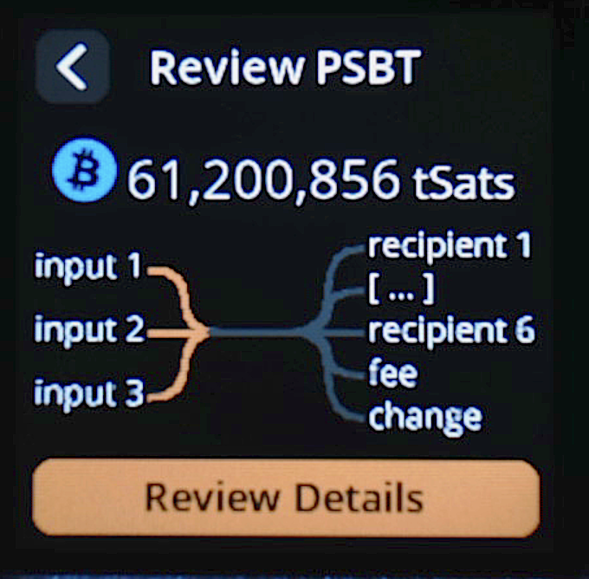
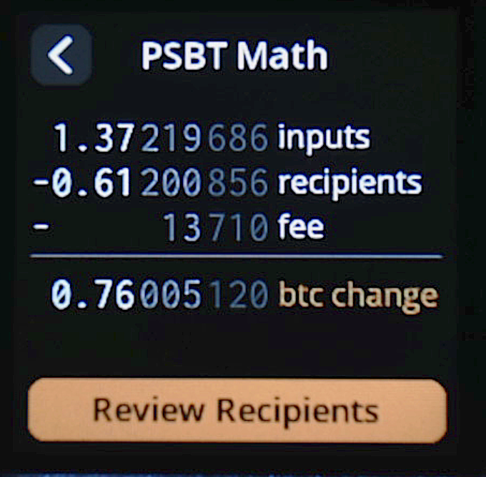
…Womp, Womp… 😢😢😢

Slide 23
Zoe’s Perspective
25,000,000
each
61,206,177
22,048,847
11,200,856
1,005,120
53,964,662
fee
5,321
+8,389

Slide 24
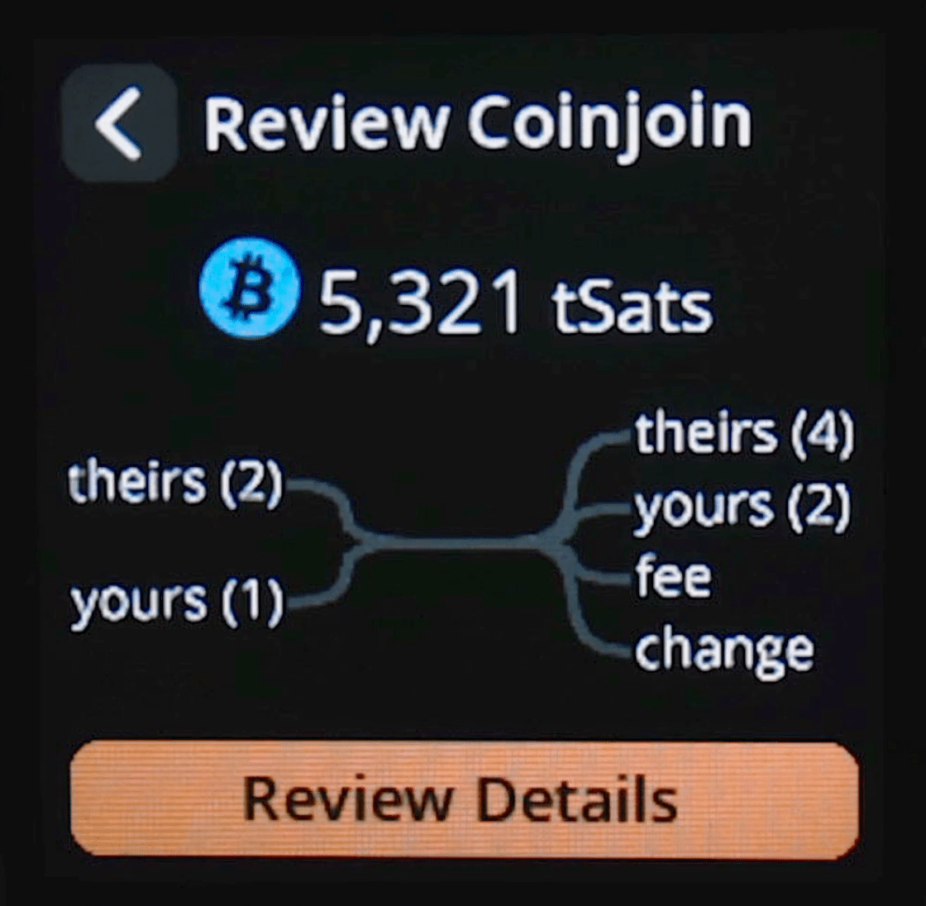
Work-in-Progress: SeedSigner coinjoin

Slide 25
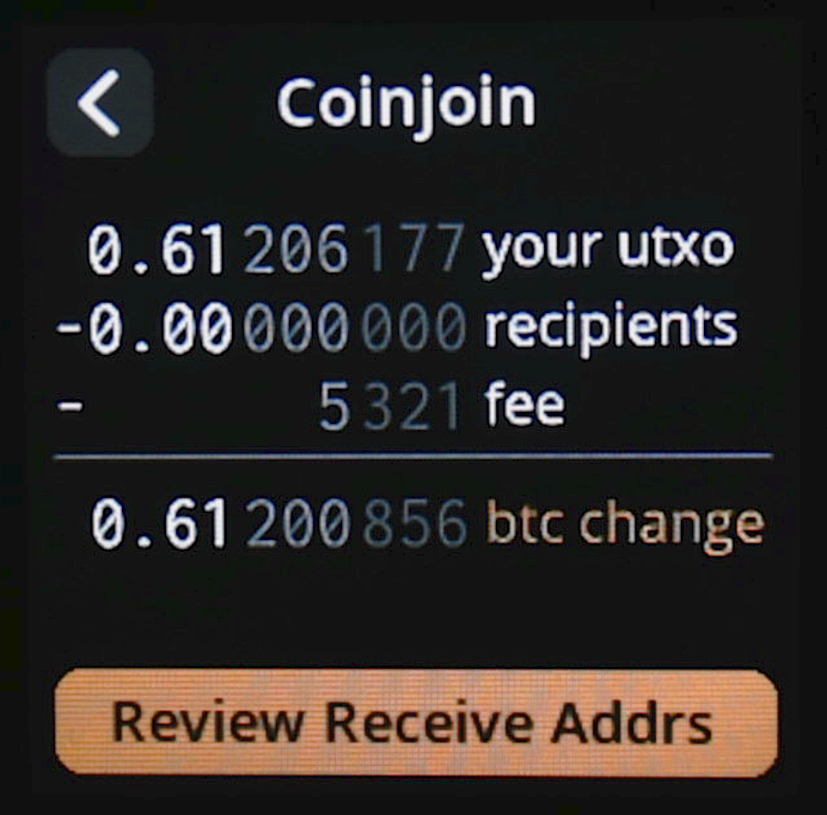
Work-in-Progress: SeedSigner coinjoin

Slide 26
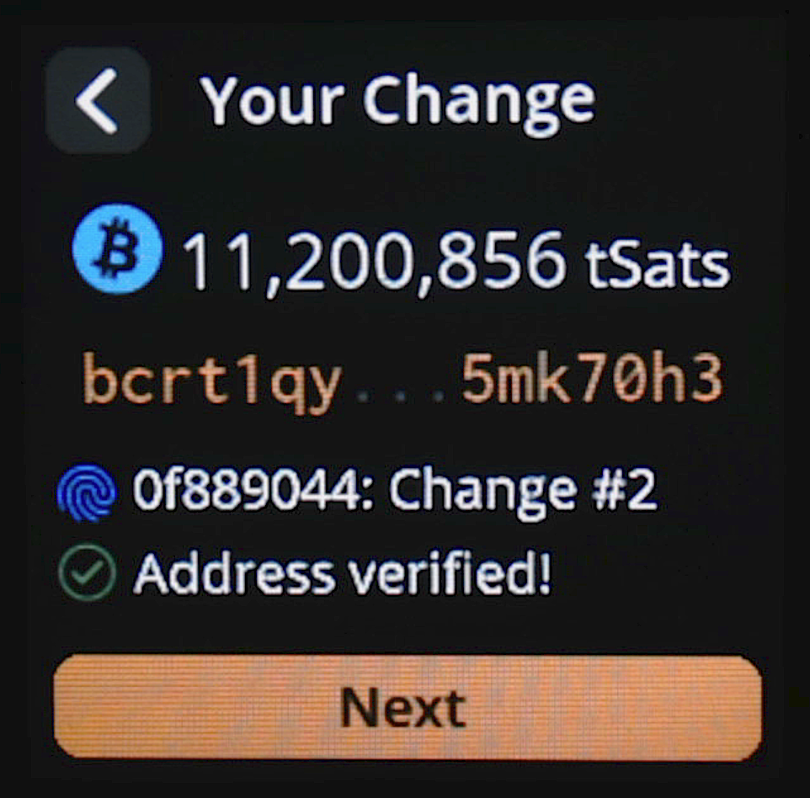
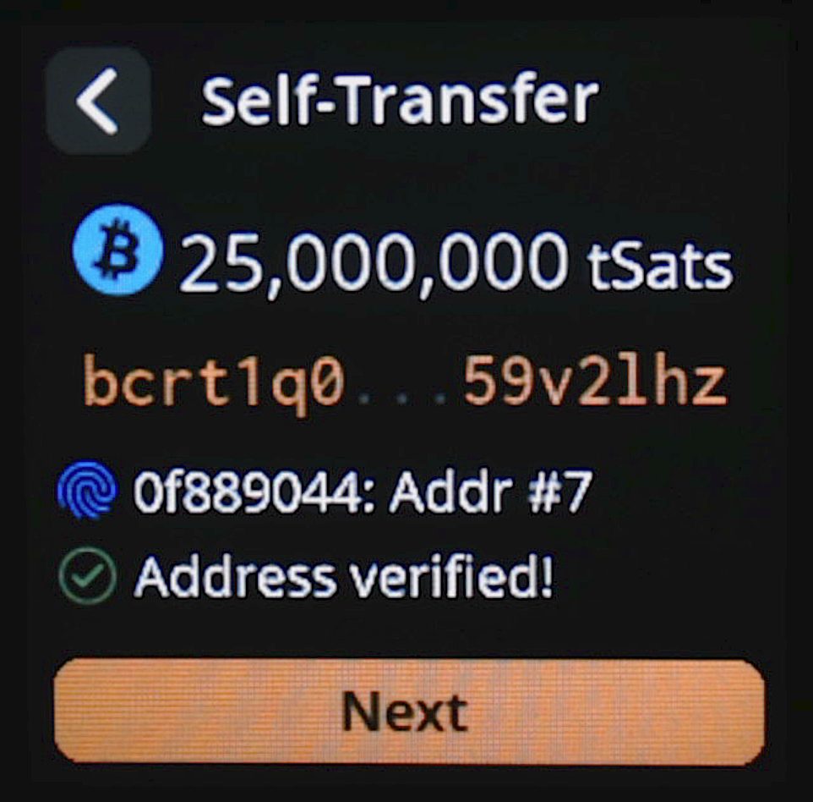

Work-in-Progress: SeedSigner coinjoin

Slide 27
Some tx contexts are unknowable
20m
?
20m
50m
?
9m
?
5m
?
5m
10m
fee
1m

Slide 28

Work-in-Progress: SeedSigner complex cooperative spend

Slide 29
Cooperative spend cheat sheet
Given a tx with 1+ input from you and 1+ external input…
Payjoin receive: your outputs > your inputs
Payjoin send: your inputs = (their outputs - their inputs) + fee
Coinjoin(?): your inputs - your outputs* <= fee
*(where 1+ of your outputs is the same size as 1+ “their” outputs)
Complex / Ambiguous(???): your inputs - your outputs > fee

Slide 30
Payjoin / Coinjoin support
Via hot wallets Payjoin Samourai BlueWallet btcpay server Coinjoin Samourai Wasabi Sparrow JoinMarket/JAM | Via HWWs / signers Software: 😢 Hardware: SeedSigner (R&D branch) 😢

